Slide 1


Slide 2


YWCA Program
Presentation
Melissa Breeden (she/her)
Vice President of Education and Curriculum
YWCA McLean County

Slide 3
RSVP
RSVP=Retired Senior Volunteer Program
Currently 450 active volunteers (avg. age 74) give their time to 75 non-profit agencies in McLean County
Pre-COVID 412 volunteers served 48, 197 hours in their communities
During COVID 330 volunteers served 29, 538 hours in their communities
Notes:
This is not always bad – ex. Teachers are nice; football players are tough

Slide 4
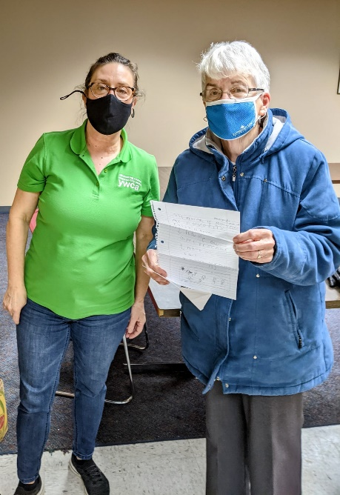
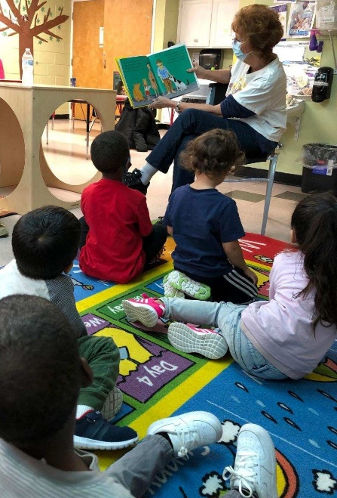
RSVP Community Impact
In 2020, RSVP Provided 2,930 free snacks to elementary schools in District 87
RSVP volunteers are pen pals to Young Wonders children and partner with YWCA educators on multi-generational activities
Children’s Discovery Museum-activity packs

Slide 5
RSVP Funding
Funded at federal and state level depending on volunteer hours reported. Our goal is to report at least 66 volunteers that have provided tutoring and veteran food/nutrition activities in the community. We also look for a local grant to match the funding we receive.
IDOA (Illinois Dept. of Aging) CNCS funding for three year grant terms. This past year RSVP received additional funds to purchase PPE supplies to keep volunteers safe. RSVP applies for a continuation of funding each year
Notes:
This is not always bad – ex. Teachers are nice; football players are tough

Slide 6
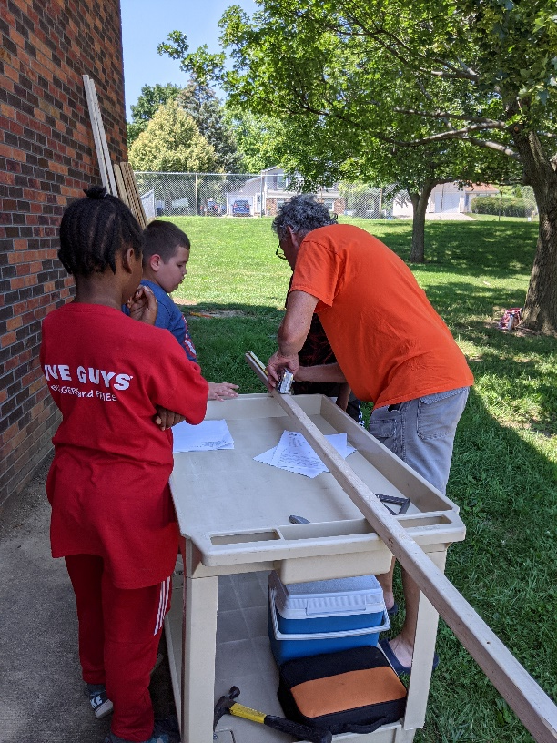
Inter-Generational Lemonade Stand
This summer, 4 RSVP volunteers paired with 4 children for a total of 7 hours on a lemonade stand inter-generational project. The children involved were 10-12 years of age and struggling behaviorally in summer camp. This group had tasks such as: planning the vision of the lemonade stand, measuring 2x4s, cutting with saws, hammering nails, and assembling the stand. During this process, YWCA teachers noticed a decrease in concerning behaviors and that children were focused and excited about the project.

Slide 7
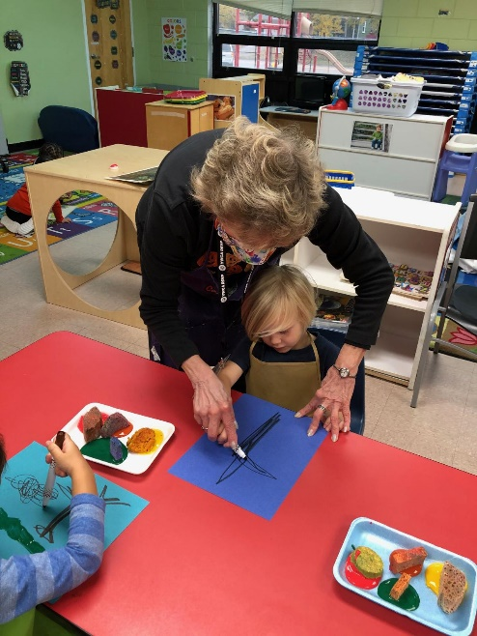
RSVP Goals
More in-person Inter-generational activities
Increase support to Veterans, including a nutritional component
Deliver nutritious snacks to district schools
Connect with stations to re-educate them on what RSVP can do for their business
Notes:
This is not always bad – ex. Teachers are nice; football players are tough

Slide 8
RSVP Request Process
Fill out a RSVP form on our website to either join as a volunteer or request assistance from RSVP for your non-profit organization https://ywcamclean.org/what-we-do/adult-services/rsvp/
If you are aware of a non-profit needing RSVP assistance reach out to Jill Miller RSVP Program Specialist at jmiller@ywcamclean.org
Notes:
This is not always bad – ex. Teachers are nice; football players are tough

Slide 9
contact
For questions or additional information.
Melissa Breeden
Vice President
mbreeden@ywcamclean.org
Notes:
This is not always bad – ex. Teachers are nice; football players are tough

