Slide 1

University of Illinois Extension is the flagship outreach effort of the
University of Illinois at Urbana-Champaign
We offer evidence-based educational programs to residents of Illinois in all 102 counties

Slide 2

Program Areas- Livingston, McLean & Woodford Counties
Family & Consumer Sciences
Nutrition & Wellness
Consumer Economics
Agriculture & Natural Resources
Horticulture
Small Farms Local Foods
Youth Development
4-H
Unity Community Center
Family Life
SNAP-ED
STEAM in the classroom

Slide 3
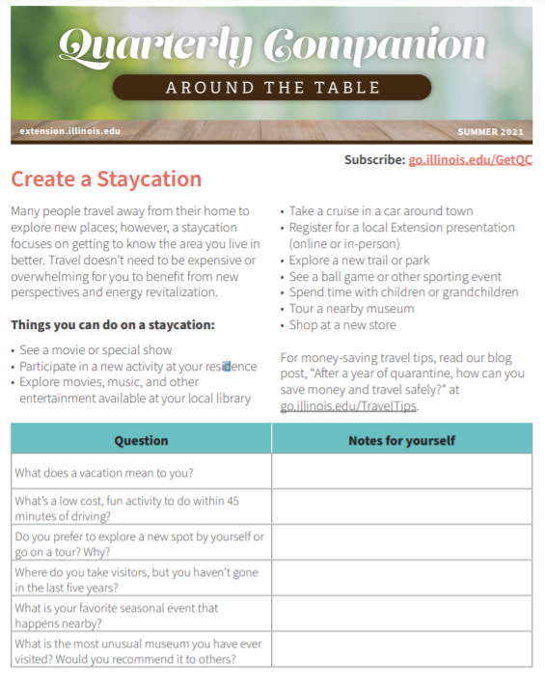
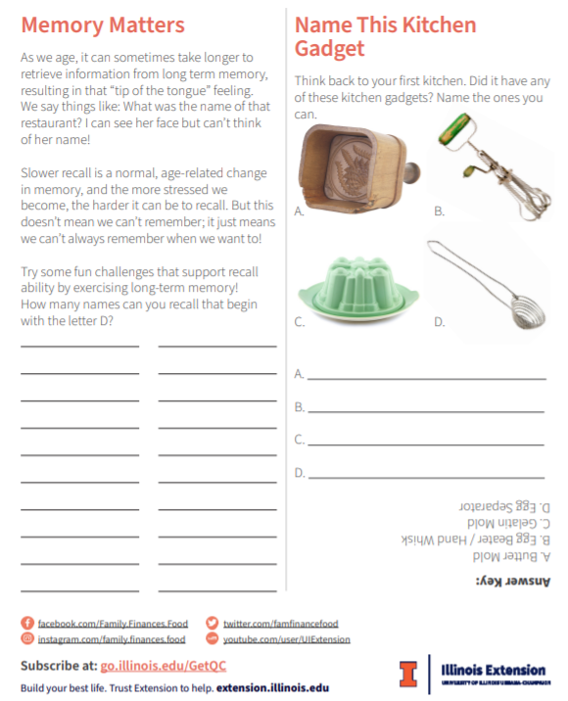
Notes:
Quick reads on nutrition, family, and finances
Tips for healthy living
Brain-engaging activities
Receive Quarterly Companion by subscribing at go.illinois.edu/GetQC. Once every three months, you can expect to see a new free issue! Download, print, and share this free resource as outreach to support your community.
go.illinois.edu/GetQQ

Slide 4
Wits Workout
to provide purposeful opportunities for older adults to engage intellectually
to increase their socialization through ongoing group participation
Available for $75.00 + S&H
go.illinois.edu/buywitsworkout
Notes:
Wits Workout is a peer-reviewed, pilot tested, brain health resource tool developed to assist leaders who provide programming to older adults in community settings. Based on the research that intellectual challenge and social connectedness are two of several factors that contribute to brain health throughout life, Wits Workout has two main goals—to provide purposeful opportunities for older adults to engage intellectually, and to increase their socialization through ongoing group participation.
This 264 page facilitator’s guide consists of 24 themed units, each accommodating a 60–90 minute face-to-face program. Length of the session can be modified by the number of activities utilized. Sessions can be offered weekly, biweekly, or monthly, and can stand alone or be presented as a series.
Units include:
• Leader guides
• Printable activity handouts
• Answer sheets
Whether you are an experienced leader or novice, Wits Workout makes it easy to lead discussions and facilitate a shared learning experience.
Three different options to purchase:
Wits Workout Printed Manual - $75.00 + $10.00 S&H = $85.00
Wits Workouk on USB Drive - $75.00 + $5.00 S&H = $80.00
Wits Workout Discounted Combo Pack including both Manual and USB - $115.00 + $10.00 S&H = $125.00

Slide 5
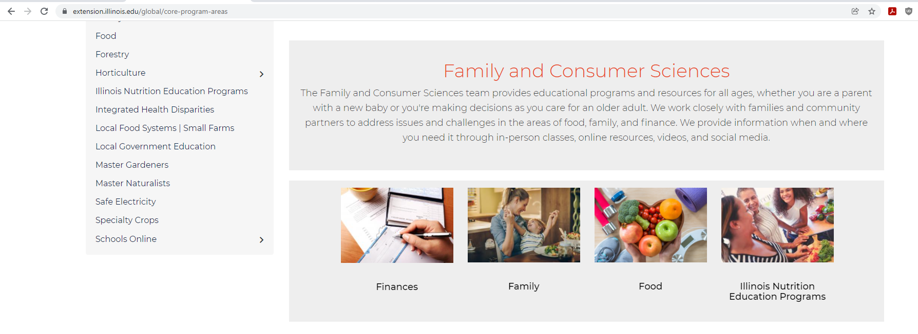
Explore our website!
extension.illinois.edu

