Slide 1
Brief Overview of Care & Support Services Related to RDI
Early Stage Services
Younger Onset Services
Community Education Programs
Caregiver Support Groups
ALZConnected
24/7 Helpline

Slide 2
Early Stage Services
MCI (mild cognitive impairment)
Early stage dementia
PWD
Care Partners
Pre-screening required for PWD
Virtual or Phone participation only

Slide 3
Early Stage Support Groups
8 week group
PWD and Care Partners meet separately
Current one runs through November 29
Early Stage Social Engagement
Focus on physical, emotional and social health
Schedule: last Tuesday of the month, 10:30 am – 11:30 am
September – Virtual program presented by Lincoln Park Zoo

Slide 4
Younger Onset Services
Under age 65
Low attendance pre-Covid
Presenting Regionally
MCI (mild cognitive impairment)
All Stages
For PWD and Care Partner
Pre-screening required for PWD
Virtual or Phone participation only
Education programs and specialized Support Groups
Notes:
Support groups include:
Younger Onset Caregivers
Young Adult Children of People with Younger Onset

Slide 5
Community Education Programs
Virtual
Live Q&A
Virtual environment has allowed offering of specialized programs such as LWA series
“Bonus Content” and special events
Family Conference on November 13; includes education, guest speakers, healthy cooking demonstration, chair yoga
New: Watch Parties – 5 scheduled in 2022
Notes:
Watch Parties can be set up by organizations through us – allows the organization to host the event virtually for in-person viewers who would otherwise not have a way to view it – ex: Senior Centers, living communities, churches, etc
Watch Party info:
1) January 20th at 12pm – Healthy Living and the State of the Planet with Mission Wildlife
2) March 31st at 12pm – Advancing the Science
3) May 5th at 12pm – Healthy Living with a class on the Monarch Butterfly and class to build your own Butterfly Garden with Klehm Gardens
4) June 30th at 12pm Healthy Living with a Chef to make “Delectable Treats for your 4th of July Party”
5) October (TBD) – Effective Communication Strategies & Fall Activities for Family Members and Friends with Dementia (SIU/Alzheimer’s Center)

Slide 6
Caregiver Support Groups
Volunteer-led; met by phone or virtually
Creativity of Support Group Facilitators where virtual meetings were not possible: check-in calls, music by phone, contactless drop off of small items
      Virtual guest speakers

Slide 7
Other Activities and new Ideas
Weekly Newsletter – links to virtual events, games, puzzles, fun videos, music
American Greetings E-cards - $20 for a one year subscription – have musical and customizable cards!
Miller Senior Center/Alisha Dault in Pekin: radio broadcast programs in parking during Daily Bread, parking lot bingo, and drive-in movies

Slide 8
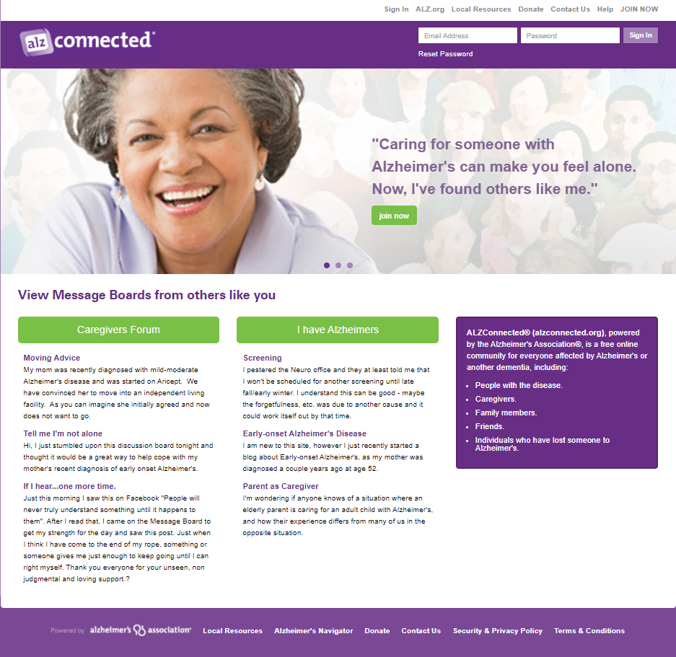
ALZConnected
Message Board
PWD
Caregivers
50,000+ Members
Share thoughts, questions, ideas with others

Slide 9
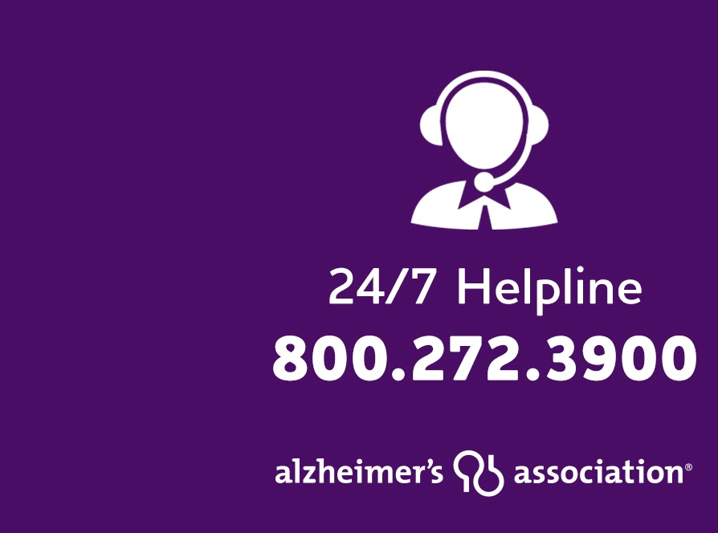

24/7 Helpline
Available around the clock, 365 days a year.
Helpline specialists and master’s-level clinicians offer confidential support and information.
Bilingual staff and translation service in 200+ languages
Live chat available.
TTY Service 866.403.3073

