Slide 1



Slide 2
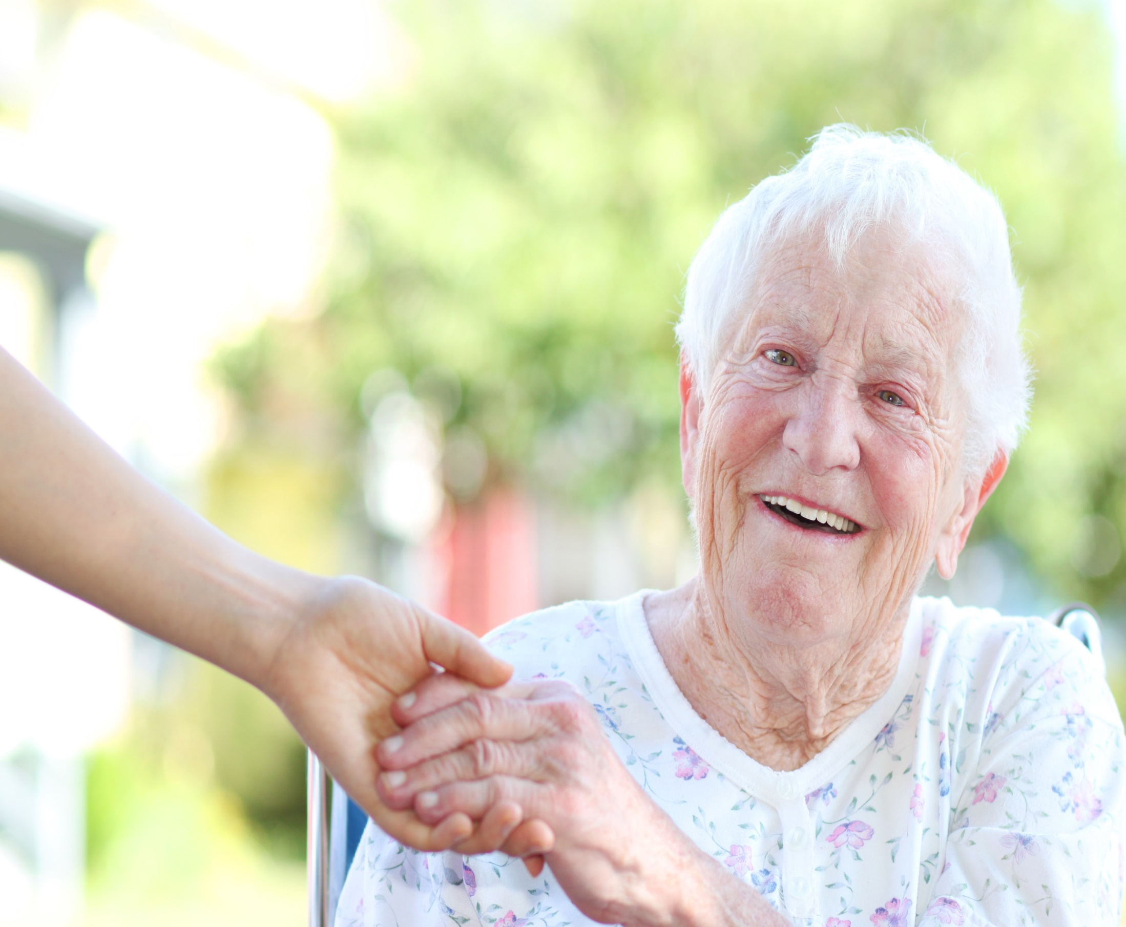
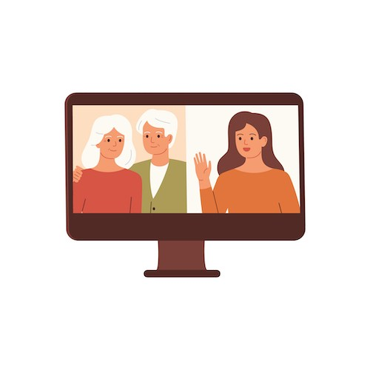
Technology to Reduce
Social Isolation
Using Amazon Echo Show 5 for ‘Face to Face’ interactions with CRIS, family and friends.
Monthly individual educational modules that outline key feature of the Echo such as :
    Face to face calls w simple voice commands,
    Medication reminders,
    Alerting an emergency contact,
    Alarms and timers,
    Family ‘drop in’ option,
Monthly tutorial (through device) about new features and social stimulation call.
U of I Health, Aging and Technology Dept. provides evidence-based training and research.
4. UCLA loneliness scale’s administered before they get the device, 3-months, and 6-months.

Slide 3



Monthly Education Modules
Each month:
Clients receive an education module about a ‘skill’ of Alexa. We also include other CRIS information and vaccine updates.
They then receive a call through the device for an individualized tutorial about the skill and social stimulation talk.
For the first 6 months all participants learn core these skills:
How to use their device (Ask it questions, use the home screen etc.)
Video calling –
Adding contacts -
Alarms & Timers
Setting Reminders
6. Care Hub
.

Slide 4
Impacting Social Isolation
Education Modules teach skills about the device and how it can be used to combat social isolation.
For example:
How to interact with friends and family ‘face-to-face’
Reminder to take medication that might assist w depression or reminders to reach out to friends.
Alarms to attend an online class such as Aging Mastery and make new friends.
Care Hub to feel less anxiety because they have emergency contacts ready to assist them.
A playlist with favorite upbeat songs to improve their mood.
.

Slide 5
Social Stimulation Calls
Each month, when we calling each client to talk about their device, we will also discuss a topic with them to build rapport and stimulate them socially.
October: Medicare open enrollment Oct 15 – Dec 7.
November: The Holiday Season! Halloween and Thanksgiving
December: Christmas/Hannukah
January: New Years Resolutions
February: How CRIS Can help you with your taxes!
March: CRIS Aging Mastery Classes
April: Easter/ Spring
May: Gardening and other outdoor activities!
June: Summer Plans
July: 4th of July
August: Back to school
September: Fall

Slide 6
Progress to Date : Clients and Units
7 Cohorts of participants so far.
  Groups A thru G
Group A (2019)
  30 participants
Group B (2020)
  45 participants
Group C (2020)
  15 participants
Group D (2020)
  30 participants
Group E (2021)
  45 participants
Group F (2021)
  35 participants
Group G (2022)
  45 participants

Slide 7
FY 2022 Focus:
Home Delivered Meal Clients
In July we began a focus on those receiving of our new RSI clients home delivered meals through CRIS once a week.
18 started in July.
45 to start in November, HDM continues to be our focus.
This is one of our most isolated and vulnerable populations.
CRIS nutrition staff will be doing weekly wellness calls with their clients through the device.
Administer UCLA loneliness scale tests through the device.

Slide 8
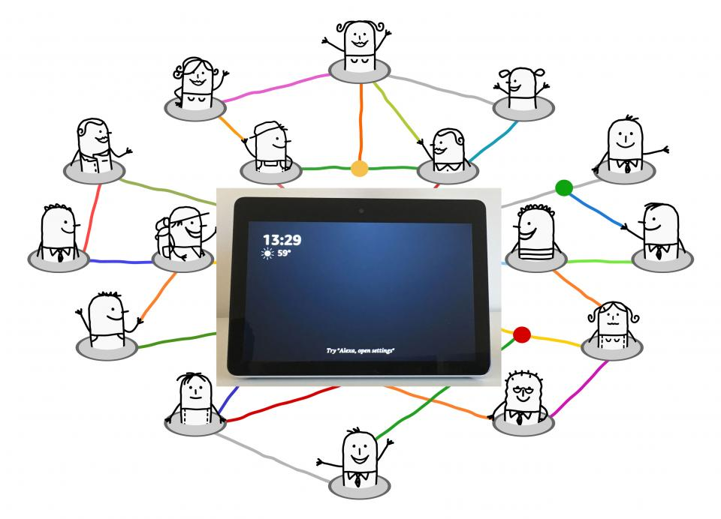
Outcomes : It Works!
Socially isolated clients describe feeling lonely and missing seeing their friends and family. The CRIS program addresses this and reduces their isolation.
  Device increases the depth of communication with family and friends.
  Participants report increased the frequency of contact with family
  and friends that they are not able to see in person regularly.
  Over 90% of the participants regularly use their device.
  Participants who are most isolated show the largest decrease in
  reported loneliness after participating in the program.

Slide 9
UCLA Loneliness Scale
Before Starting the program
3 months
6 months
.

Slide 10
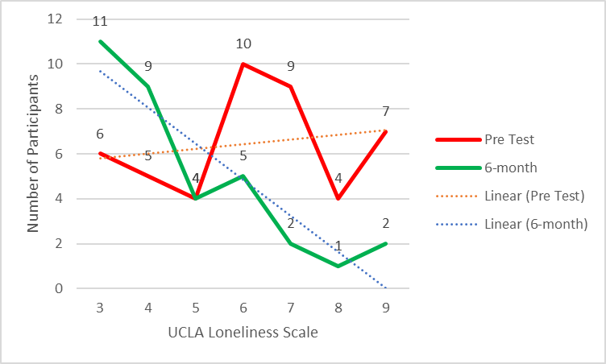
Loneliness Scores 2021
.

Slide 11
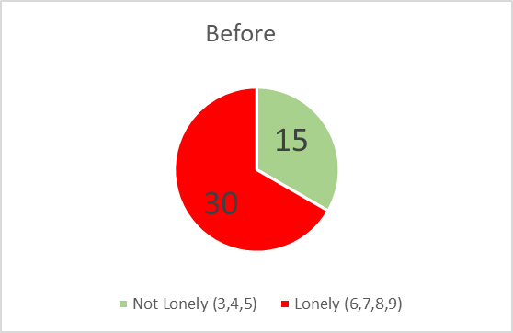
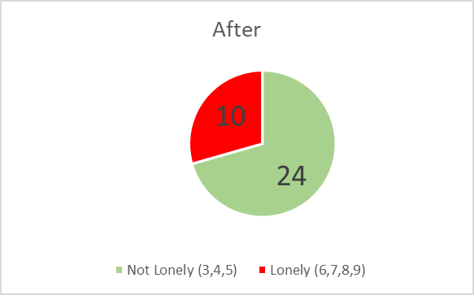
Loneliness Scores after 6 months
.

Slide 12
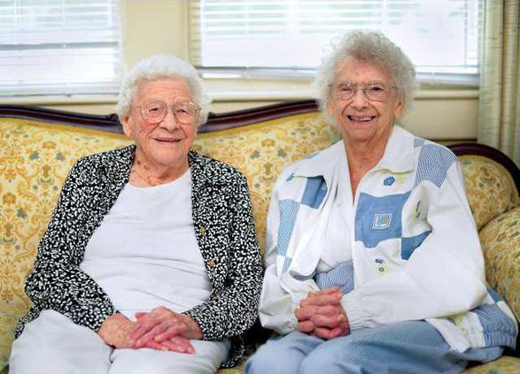
Client Impact Story
Iris has an underlying health condition and took the COVID-19 safety precautions very seriously and was not seeing anyone in person. Iris contacted us feeling sad and lonely. Iris used to see her sister every few days and she was missing spending time with her. Iris and her sister were referred to our RSI program.
The CRIS RSI Technology + Education program provided them each with Amazon echo show screen-based device. Iris and her sister were taught to use their devices to ‘see’ each other. After learning how to use the device, they started making daily video calls to each other, and have been doing so ever since. The eat dinner together, watch TV together etc.. They say they spend much more interacting on the device than they would on a phone call.
Iris now feels like she isn’t isolated at all. This has opened all kinds of opportunities for her, as she has started video calling with all of her family and friends while staying safe.
.

Slide 13
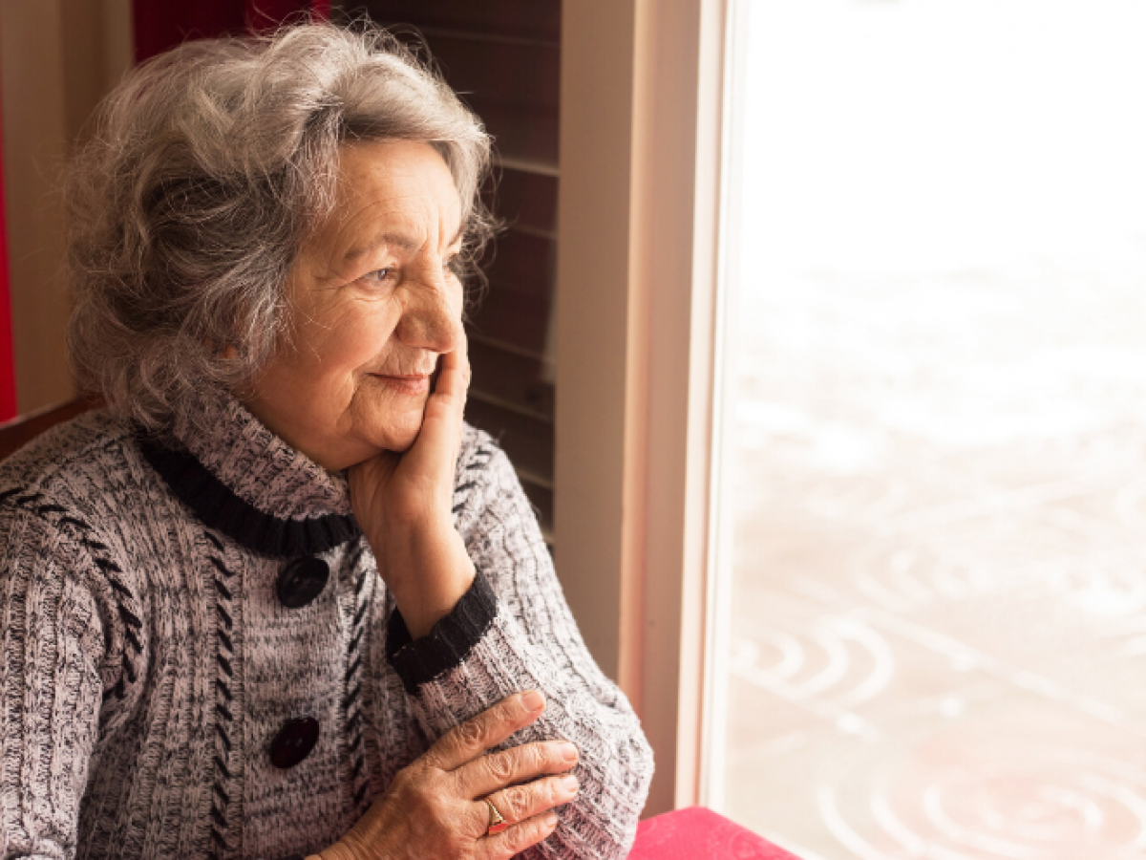
Client Impact Story
Barb is an older adult in the community who also participated in our program. She plays country music every morning and sets alarms on Alexa to wake her up at 7 AM sharp! Her daughter lives in Connecticut and hasn’t been able to visit much lately. Since getting the device, she has been able to talk with her daughter often and she really enjoys that. She said that she is “very blessed and grateful to have an opportunity to join this program”.
.

