Slide 1

Reducing Social Isolation Pilot Programs
CCSI Case Coordination, llc., Mclean County

Slide 2
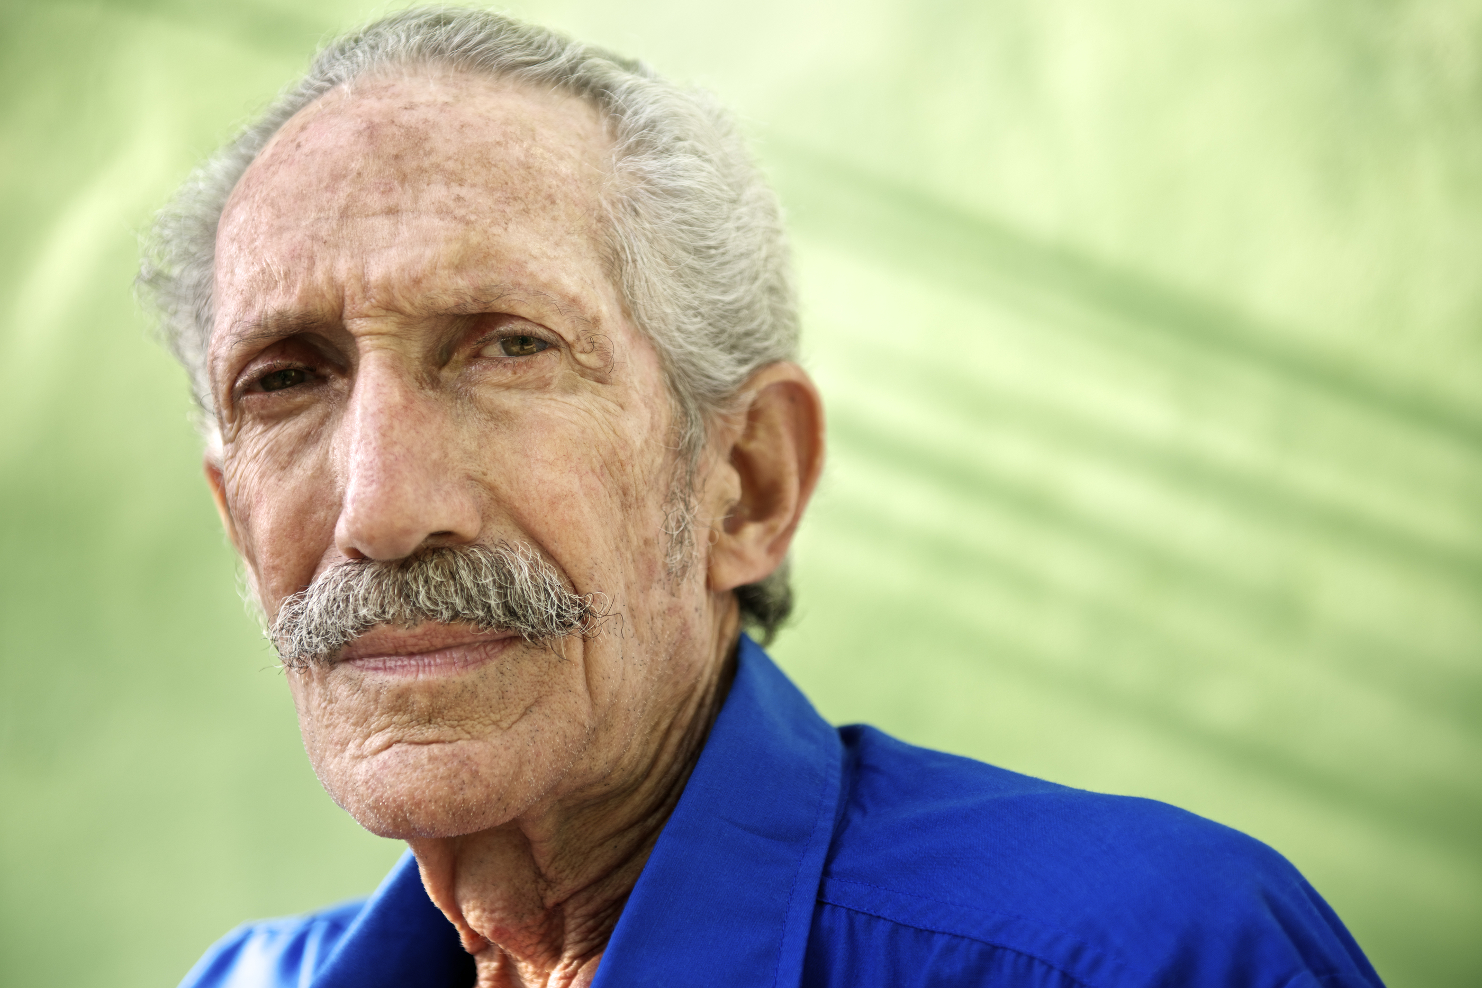
Building momentum
2018: CCSI was invited to attend the monthly ECIAAA Reducing Social Isolation Coalition in response to a statewide initiative to investigate and reduce social isolation in older adults.
The committee developed a vision for future collaborations, identified barriers, explored definitions and research on different tools used to measure social isolation in older adults.
2019: CCSI McLean County CPOE/SIS approached by ECIAAA to start RSI Pilot program to target underserved populations
Targeting: Grant specified vulnerable populations to be focus of Pilot as Hispanic/ESL Population & Alzheimer’s Disease and Related Disorders populations
Social Isolation, defined:
“Social Isolation is the distancing of an individual psychologically or physically, or both, from his or her network of desired or needed relationships with other persons.”
Nicholson, N.R. 2012

Slide 3
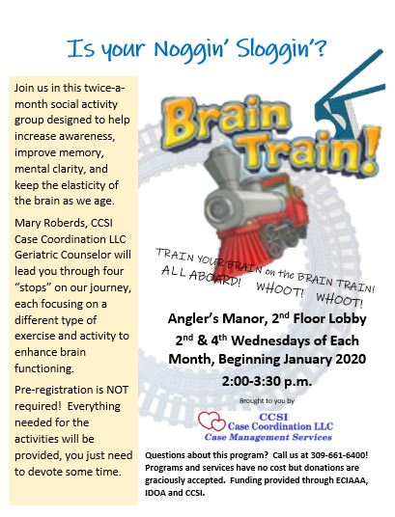
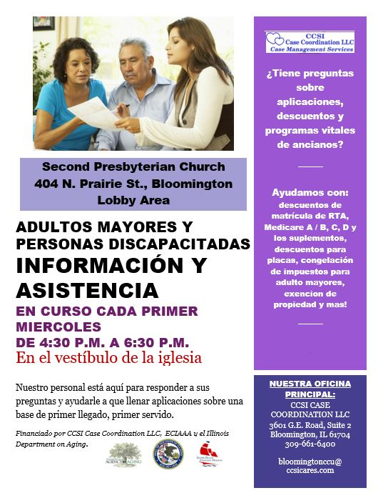
Development
Kristin Bane, CCSI Geriatric Counselor in 2019, received feedback form participants who resided in a Bloomington Senior Apartment building that the residents felt isolated and were being discouraged from interacting. CCSI felt this would be an opportunity to not only provide change for the Angler’s Manor residents, but an opportunity to study how a structured activity might impact residents’ perceptions of their social isolation. The Brain Train bi-monthy activity group was developed and implemented in January 2020 at Anglers Manor in Bloomington. Alayna Moore, CCSI’s current Geriatric Counselor, continues this group.
Annette Morrison, CCSI CPOE/SIS Supervisor, started exploring collaborations in the community to provide an introduction to the local Hispanic population. Western Avenue Community Center was an ideal contact, but due to funding challenges and administration issues, this collaboration was not possible throughout 2020.
Through her contacts in SHIP, Annette was able to reach out to a participant who was also a Pastor at Bloomington Restoration Church and voiced an interest in helping develop a Hispanic Outreach at their venue, the 2nd Presbyterian Church in Bloomington. Pastor David Santana helped make the contacts to establish the outreach on an evening with a large prayer group meeting. The first Hispanic Outreach was held Monday, February 5th, 2020. The group requested an impromptu presentation of CCSI services which was translated to Spanish by one of their members. Many questions were asked and the outlook for the next outreach was fantastic.

Slide 4
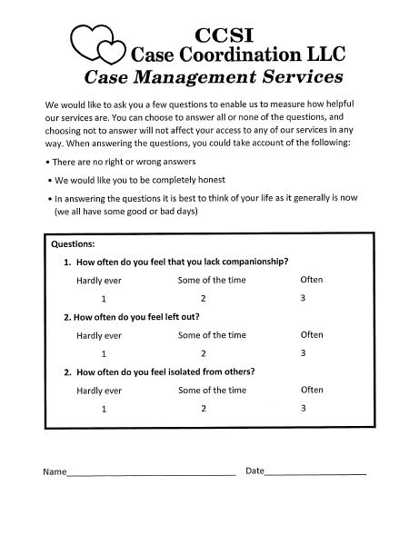
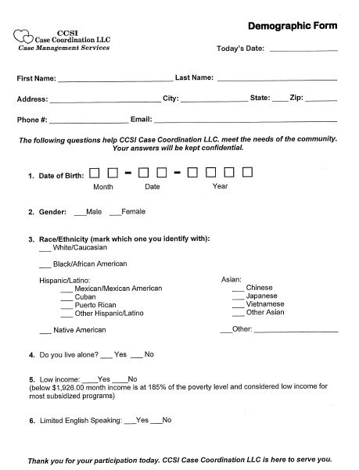
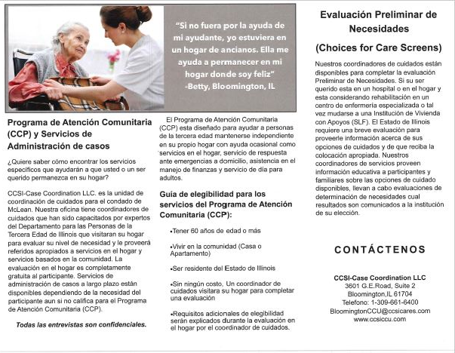
Materials Developed for RSI Pilot Study Outreaches & Alternate Language Booklets & Brochures

Slide 5
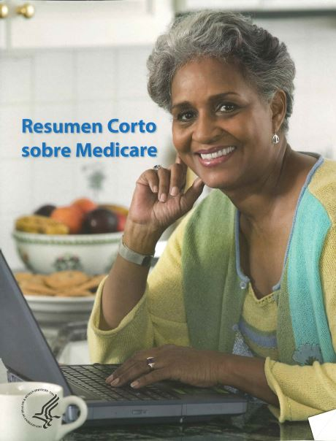


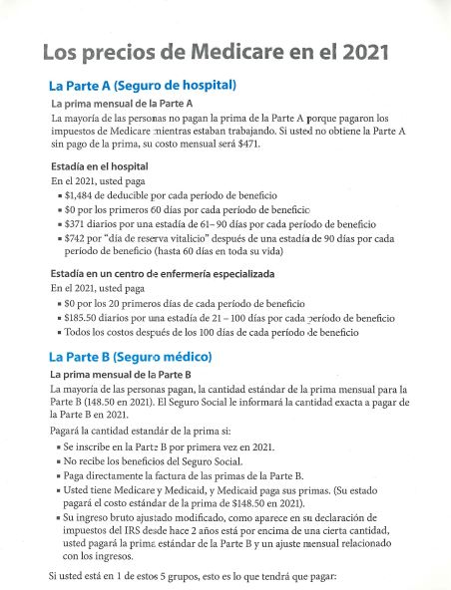

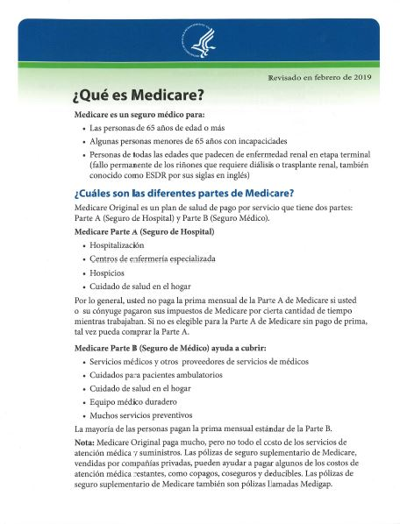
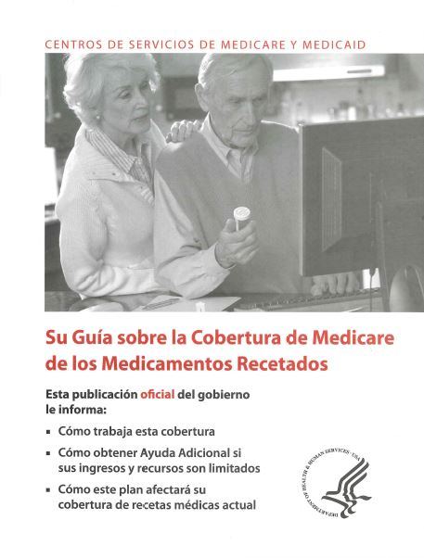
Senior Health Insurance Program Counseling Materials

Slide 6

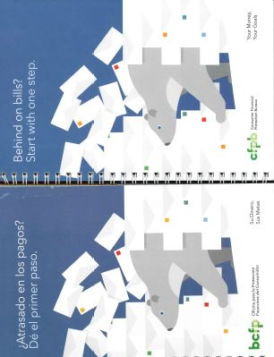
Spanish materials to help educate about scams, financial & identity security, and money management.

Slide 7

Then, Covid.
MARCH 2020. This changes everything.
TIME TO PIVOT, TO ADAPT, TO EXPLORE, TO THINK OUTSIDE THE BOX…

Slide 8

Brain Train
Anglers Manor closed its doors to outside visitors, banned group activities.
CCSI adapted Brain Train to a themed correspondence packet with UCLA Scale sent every 3rd month
Follow up calls bi-monthly to help reduce their social isolation and offer mitigation services and referrals as needed
Additional PEARLS Counseling participants added to the correspondence, so it has expanded beyond Anglers Manor residents.
Hispanic Outreach
2nd Presbyterian Church closed its doors and Restoration Church cancelled all group meetings
System of emails/text messages to Amalia Orellana sharing program flyers/resources in Spanish to various social media outlets
Material shared over the next few months included Spanish flyers for: COVID precautions, Covid Vaccination access information, Housing expense assistance, Stimulus Check updates, Covid Emergency Housing Coalition Guidelines for those needing to be quarantined, Covid Cares Act Updates, Census 2020 Updates, Masking & Social Distancing CDC recommendations, and CCSI Outreach/Program updates
Pastor Santana continues to share updates with his congregation during their online streaming services
Follow-ups with Amalia - prayer group chose to no longer meet in person
New ESL Outreach flyers continue to be shared though Restoration Church and Amalia on Social Media

Slide 9
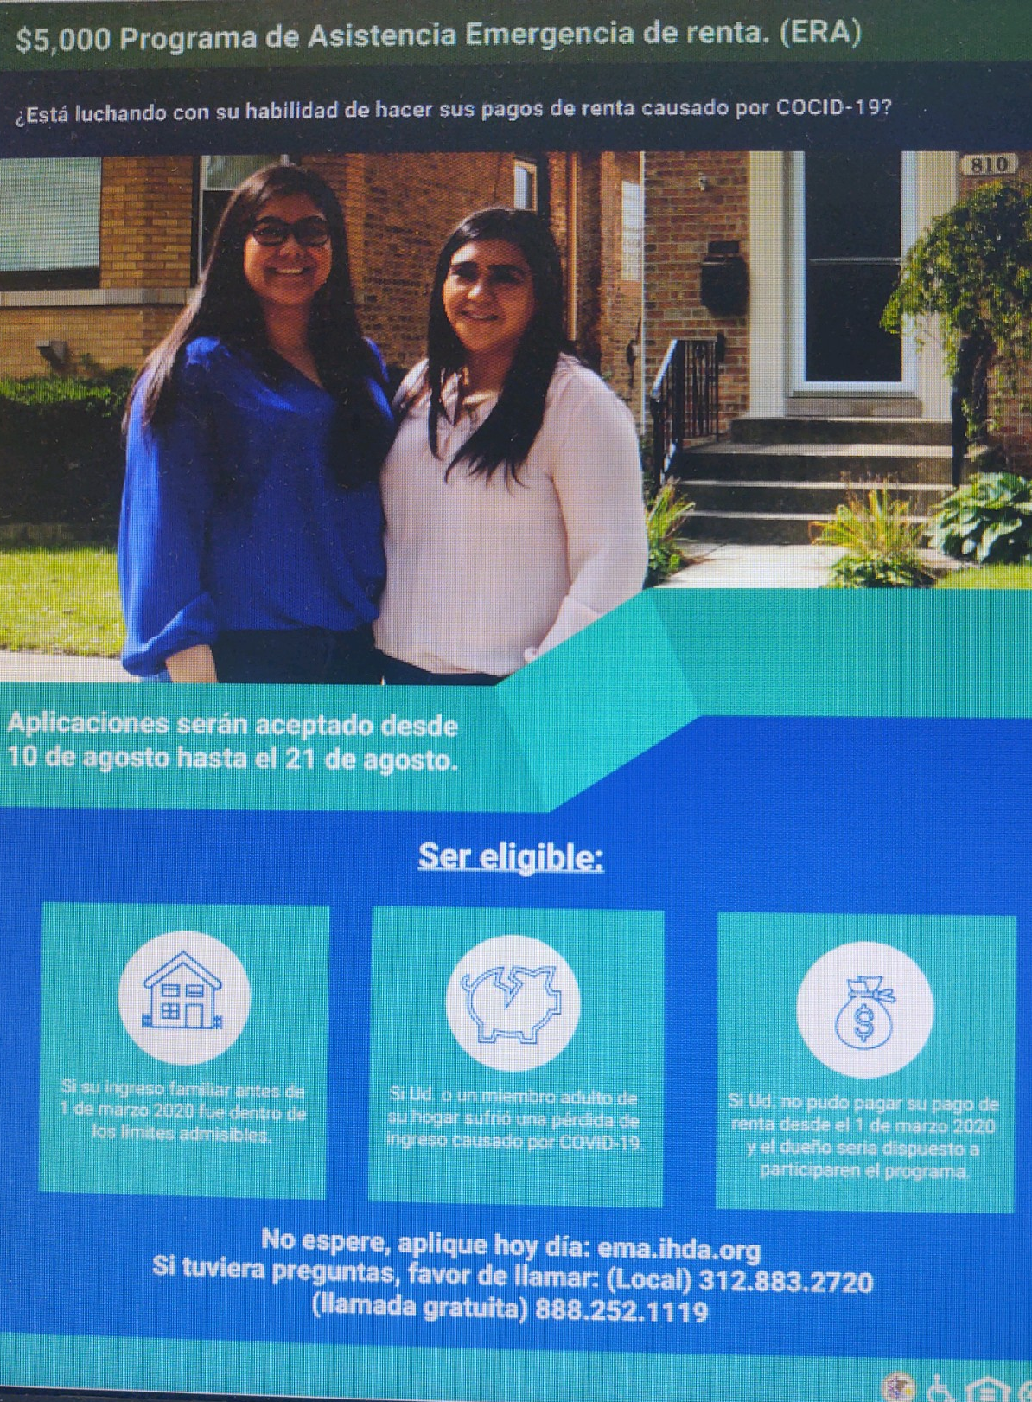
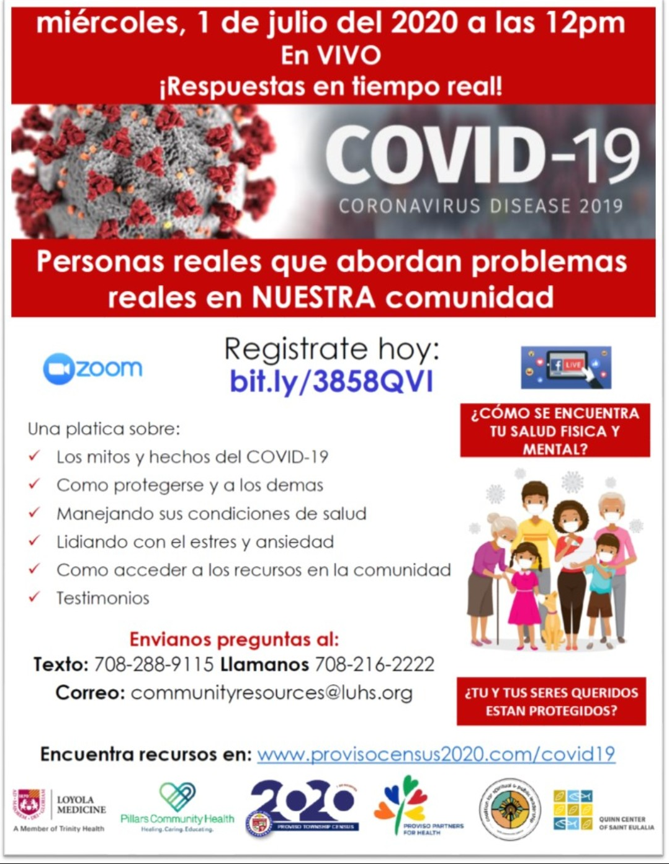
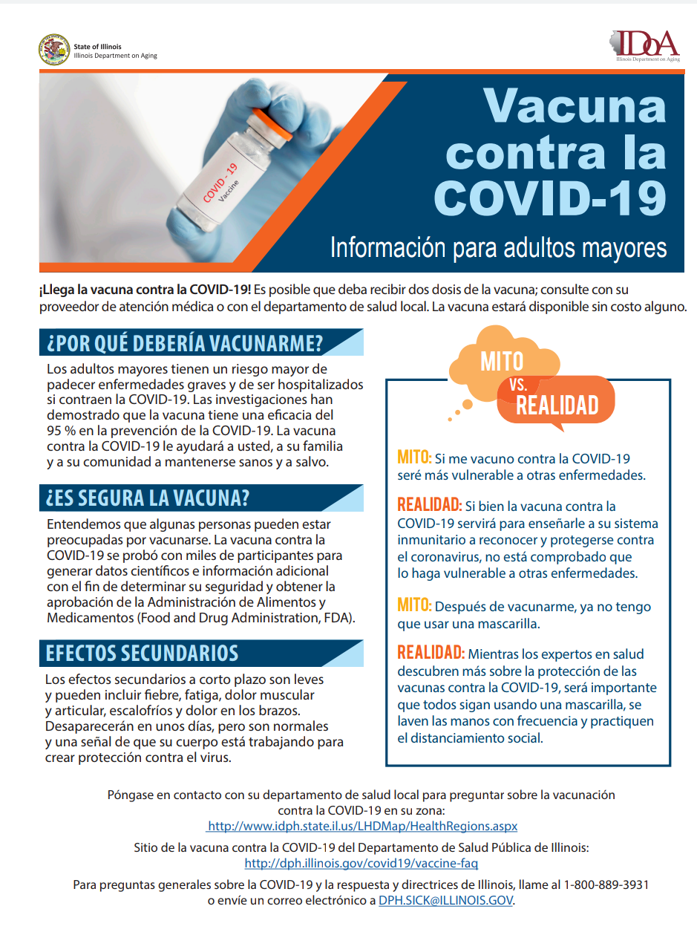
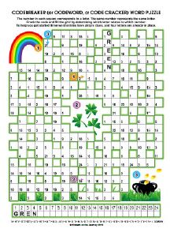
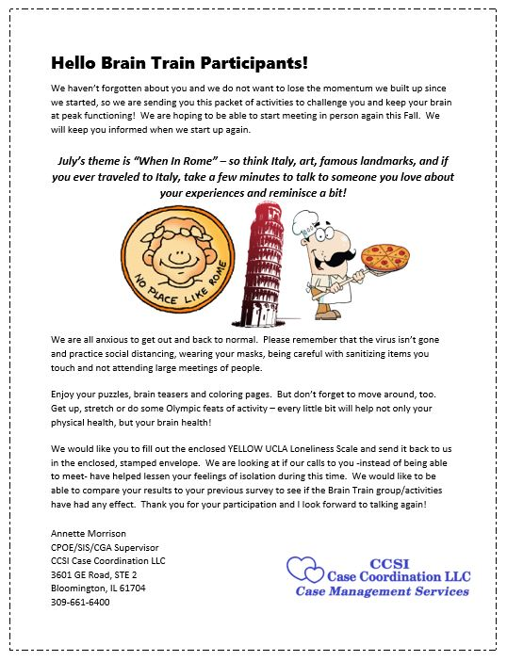
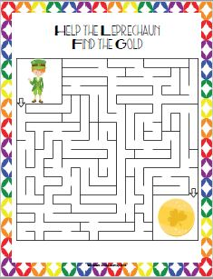
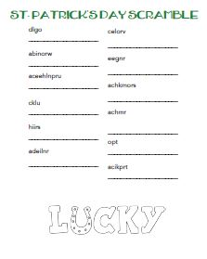
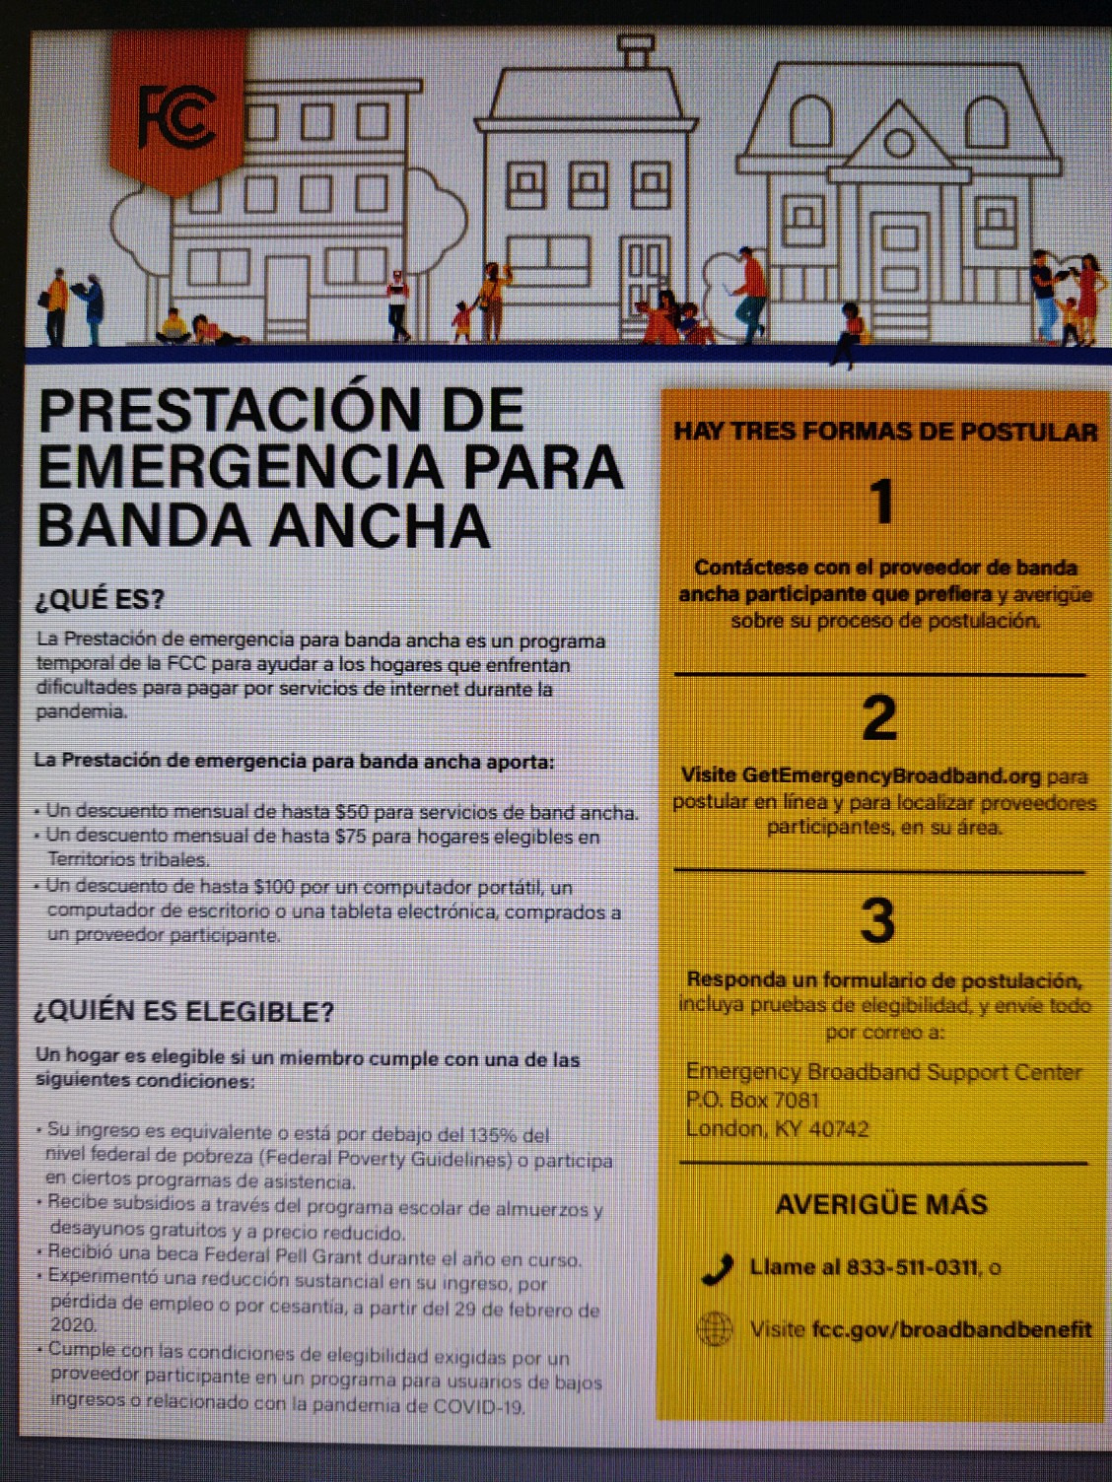

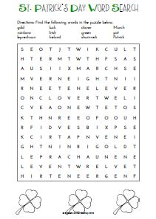

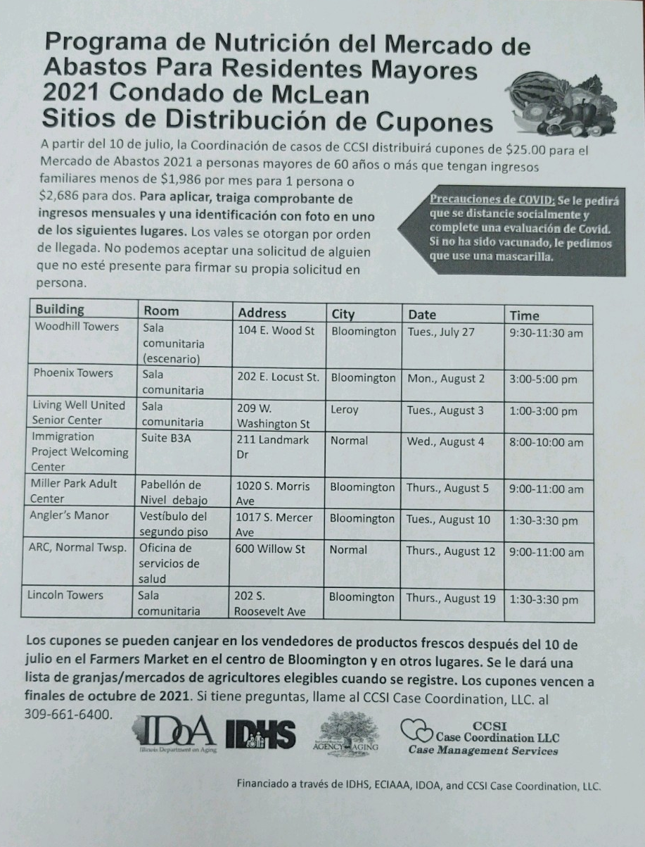
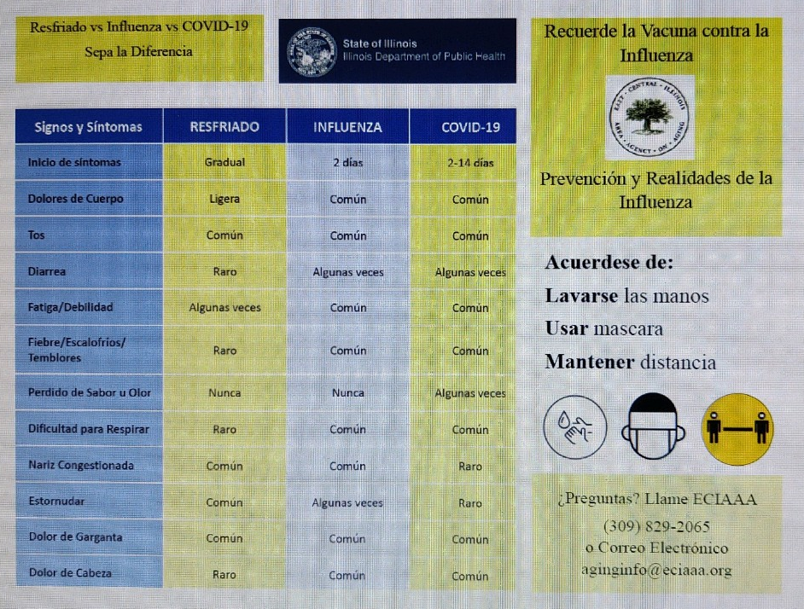
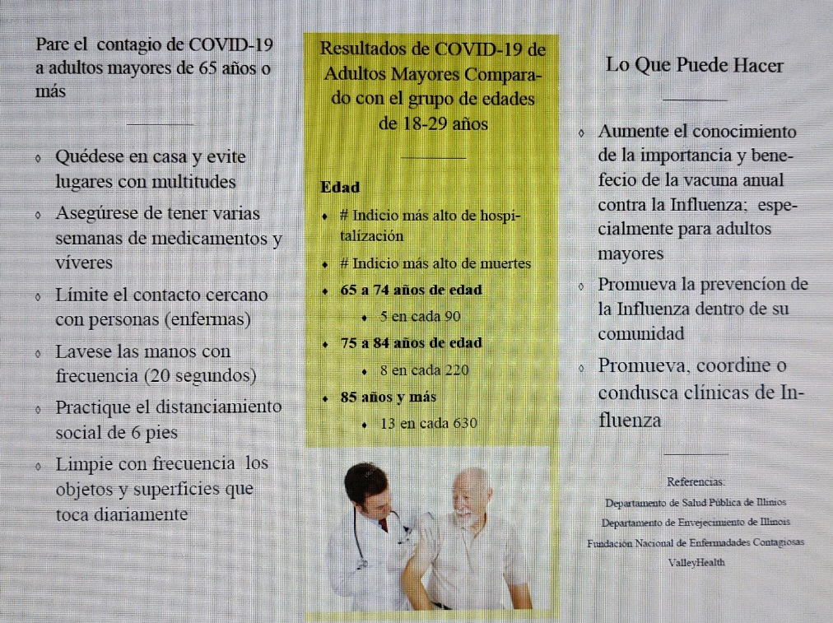
Brain Train Correspondence Packet
Social Media Shares
with Hispanic Outreach

Slide 10
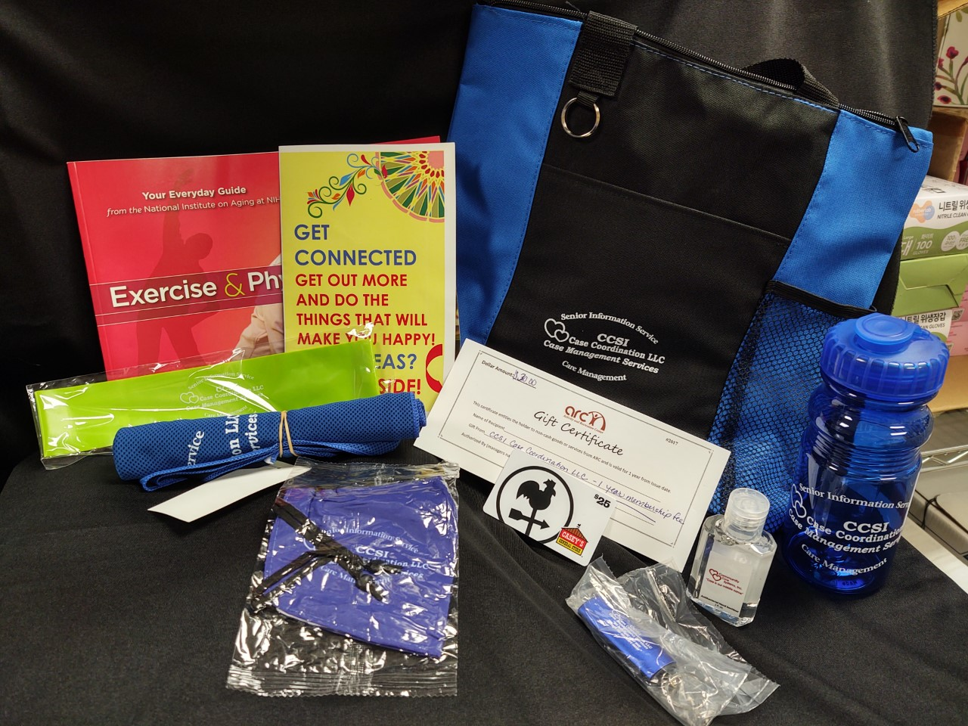
Mitigation & referrals to reduce social isolation
IL Care Connections Technology Grant Applications
Emergency Senior Service Funds, Flexible Community Service Funds, Caregiver Gapfill and Respite Funds
IL Talking Book Program
Healthy Aging Classes adapted to online platforms
New To Medicare Seminars adapted to online platform
Broadband benefit applications
Free masks, care packages, scheduling COVID Vaccination Clinics w/transportation, bi-monthly phone calls
Get Connected Virtual Program Flyer
Outreaches restarted with Covid-screening procedures, masking and sanitizing between participants
Referrals to PEARLS for depression, CCP for home & community based services, Caregiver Advisory Services, Faith In Action for transportation and Friendly visitor calls, ARC Senior Center Referrals
Get Connected Bundles: canvas bag, hand sanitizer, masks, water bottle, cooling towel, exercise band, lighted keychain, Get Connected Guide, ARC Membership, Casey’s Gas Card, Android Tablet w/WIFI

Slide 11
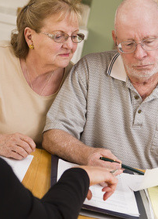
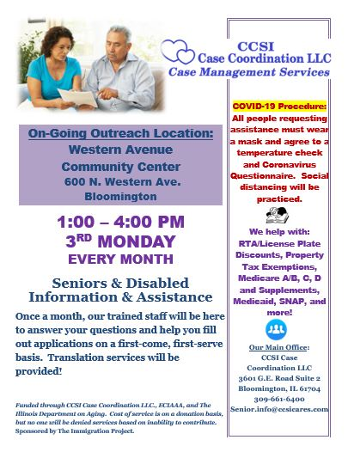
Still Growing…
ESL Outreaches added:
The Immigration Project, Normal
Started June 2021, Every month, First Wednesdays, 8:00 am – 10:00 am
Facebook Live Streams translated to Spanish for CCSI Services & SFMNP
Western Avenue Community Center, Bloomington
Started October 2021, Every month, Third Mondays, 1:00 pm - 4:00 pm
CCSI Overview Presentation September 9th to Senior Bingo Group Introducing Outreach

Slide 12
Challenges of ESL Outreach
Language Barriers: Translation services provided by Hannah Mesouani, Sarah Mellor, Soccoro Alvarez, Evelyn Harn, PocketTalk, Language Line.
Time Management: ESL Outreaches need more time for translation & explanations; multiple visits
High Complexity/Level of Need: Housing, financial, health insurance, food security, infestation mitigation, low or no income, no documentation, international travel accommodation
Cultural Differences: System of Government (USA), lack of trust of Government (Native Country), examples of documents needed (visuals), gender bias

Slide 13
UCLA Loneliness Scale results as of Oct., 2021
Number of responses not consistent from survey to survey.
Pre scores & subsequent scores from ESL Outreach do not originate from same date as did Brain Train sets
FY2021, 59 people were seen for RSI Pilot, with 549 units of contact/service provided
FY2022, thus far 33 people have been seen with 60 units of contact/service provided
Brain Train
ESL Outreach
UCLA Score | Pre* 1/2020 | 3 7/2020 | 6 10/2020 | 9 1/2021
3 | 8 | 6 | 6 | 6
4 | 4 | 0 | 0 | 0
5 | 1 | 0 | 0 | 2
6 | 4 | 1 | 1 | 3
7 | 0 | 2 | 2 | 1
8 | 0 | 1 | 1 | 0
9 | 0 | 1 | 1 | 1
UCLA Score | Pre | 3 | 6 | 9
3 | 5 | 4
4 | 4 | 1
5 | 2
6 | 3
7 | 2
8 | 2
9 | 1
*Pre-Covid scores vs follow up clearly show social isolation trend increasing due to pandemic

Slide 14
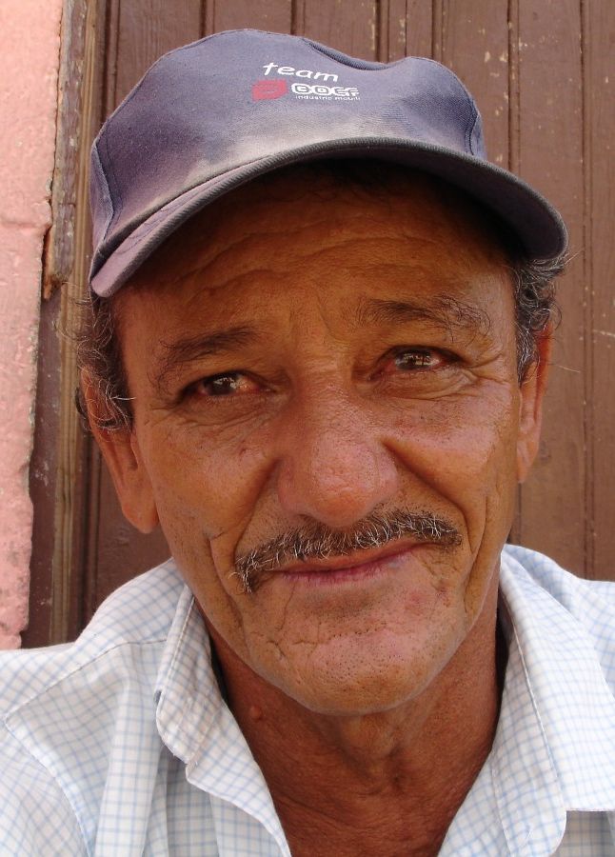
Participant story
Gentleman contacted Socorro at WACC, needed New To Medicare Counseling
Multiple retirement income sources, needed to set up drawing income from each them
Coordination of Health Insurance from retiree plan & Medicare coverage
Screened for Medicare subsidies, programs for individuals over age 65
Needed technological assistance to set up SSA account & application assistance
Required 3 separate visits, 2 hours each, Socorro translating verbal and written communication to Spanish
Multiple calls - Social Security, previous employers, Current employer, family members
Delays in gathering documents/information needed for applications and gathering accurate history data, some being held in Mexico

Slide 15
Questions?
If we do not have time for your question or you think of one later, please email
Annette Morrison at Annette.Morrison@ccsiccu.com or call us at 309-661-6400.
CCSI Case Coordination, LLC.
3601 G.E. Road, Suite 2
Bloomington, IL 61704
Phone: 309-661-6400
FaX: 309-661-9083

