Slide 1

SUNSHINE PROGRAM
Normal Township Activity and Recreation Center

Slide 2
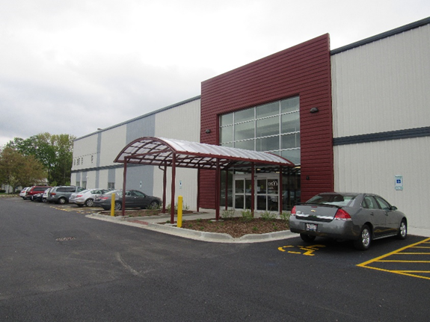
Normal Township ARC
Normal Township Activity and Recreation Center (ARC) is a 40k square foot activity center
Programming and activities reduce social isolation, promotes physical activity, and cognitive functions
More than 4000 members pre-pandemic
Congregate Peace Meal site

Slide 3
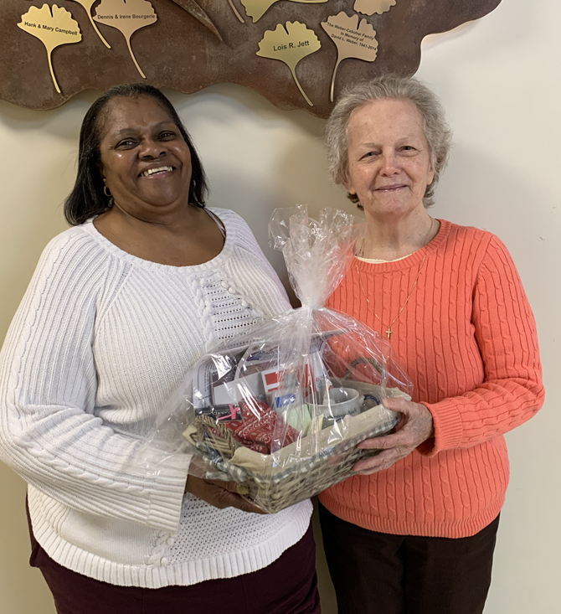
ARC Sunshine Program Description
ARC is committed to the reducing social isolation for seniors in the McLean County.
When a member is temporarily homebound due to a sickness, injury, or death in the family, the member can easily feel alone and disconnected from the ARC community.
The ARC Sunshine Program works to reduce the sense of isolation in homebound ARC members. It is a community building program designed to provide a home visit from other ARC members and a “goody basket” with variety of items to help the homebound member be comfortable during their absence, recovery, or grief from the loss of a partner.

Slide 4
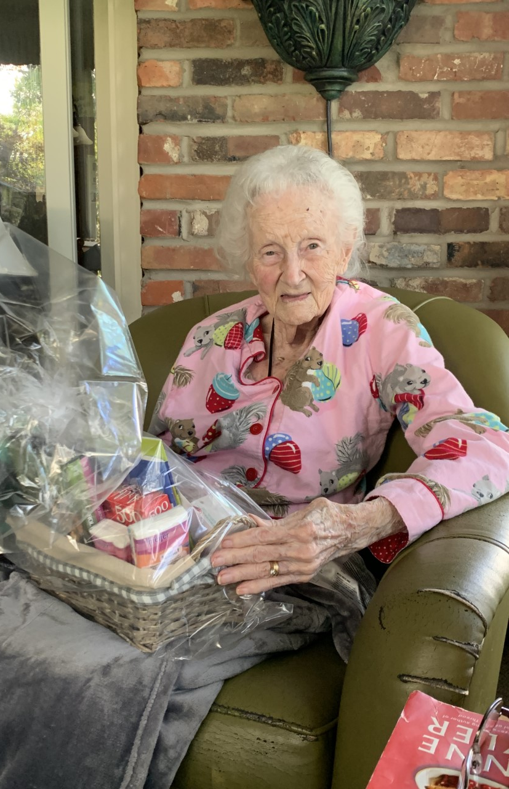
ARC SUNSHINE PROGRAM
Friendly visit
Telephone reassurance
Birthday calls
Get well cards
Sympathy cards
Notes:
A team of volunteers are available to conduct a “friendly visit” to the residence of a homebound member. Volunteers deliver a goody basket and spend one to two hours socializing with the member.
ARC member services representatives each have a call list of members to check in on.
An ARC member services representative has a daily list of birthday calls to conduct.
When ARC is aware of a member recovering from an illness, injury or death in the family, a get well or sympathy card is sent to the member.

Slide 5
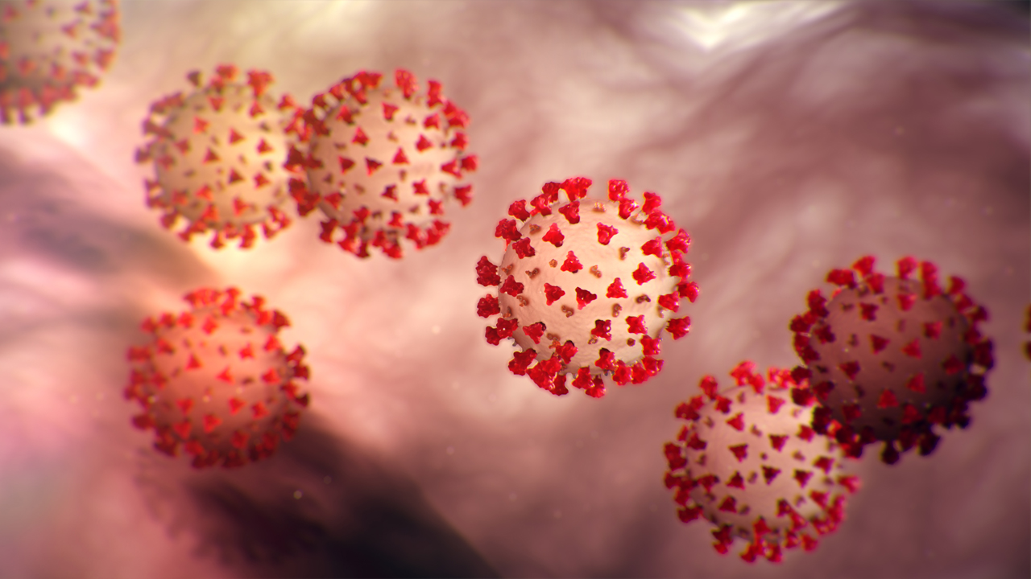
COVID-19 PANDEMIC
Notes:
The ARC suspended on-site programming in March 2020.

Slide 6
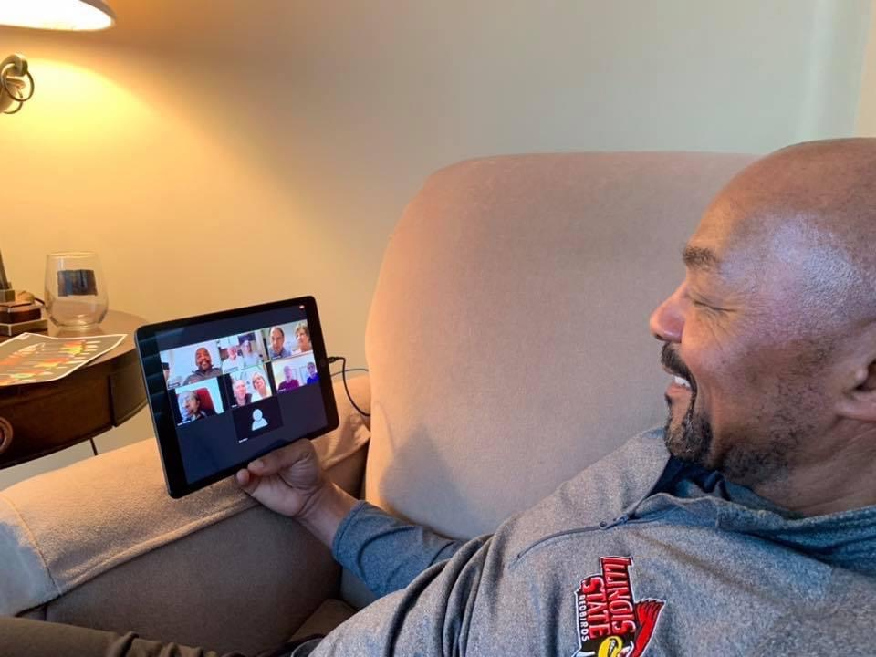
SUNSHINE PROGAM PANDEMIC PIVOT
PRE-PANDEMIC
In-Person Programming
Friendly Visits
Telephone Reassurance
Birthday Calls
Sympathy/get well cards
PANDEMIC
Digital Programming
Zoom Friendly Visits
Telephone Reassurance Expanded
Birthday Calls
Increased Use of Technology (IL Care Connections, Echo Show, Web Cams, Chromebooks)
Sympathy/get well cards
Notes:
Suddenly, all ARC members where “homebound” and unable to visit and socialize at ARC.

Slide 7
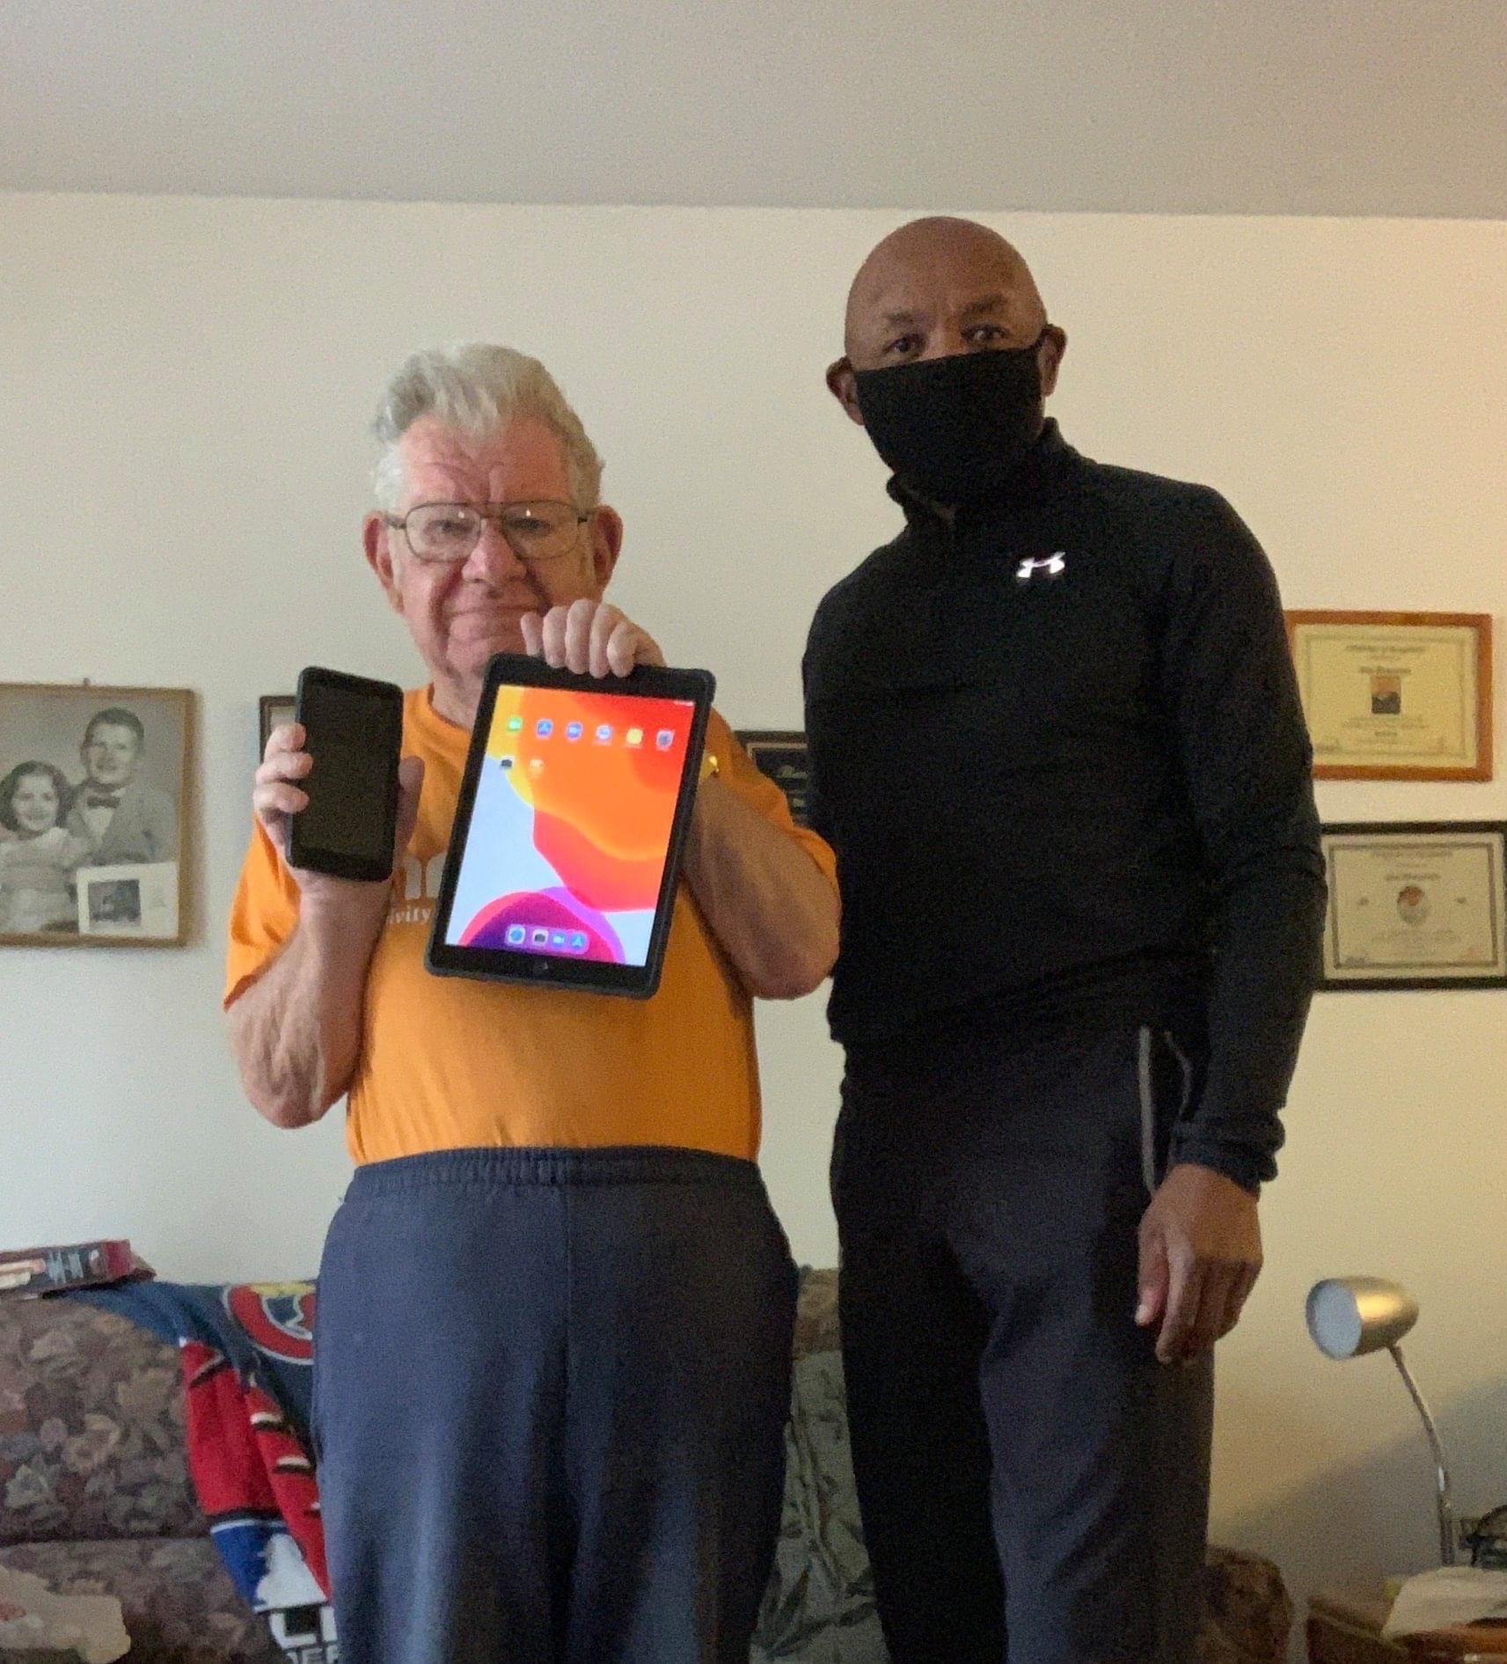
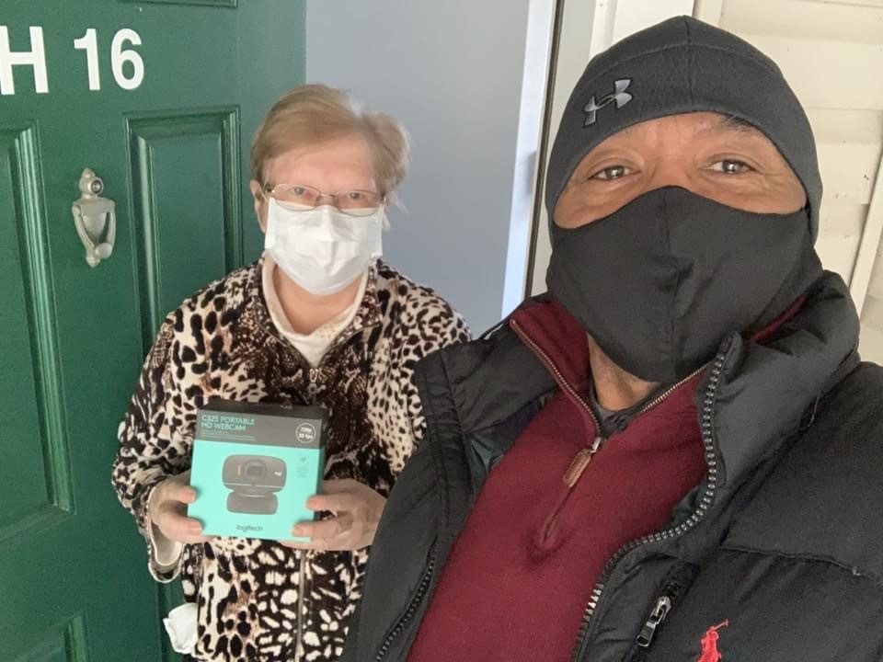
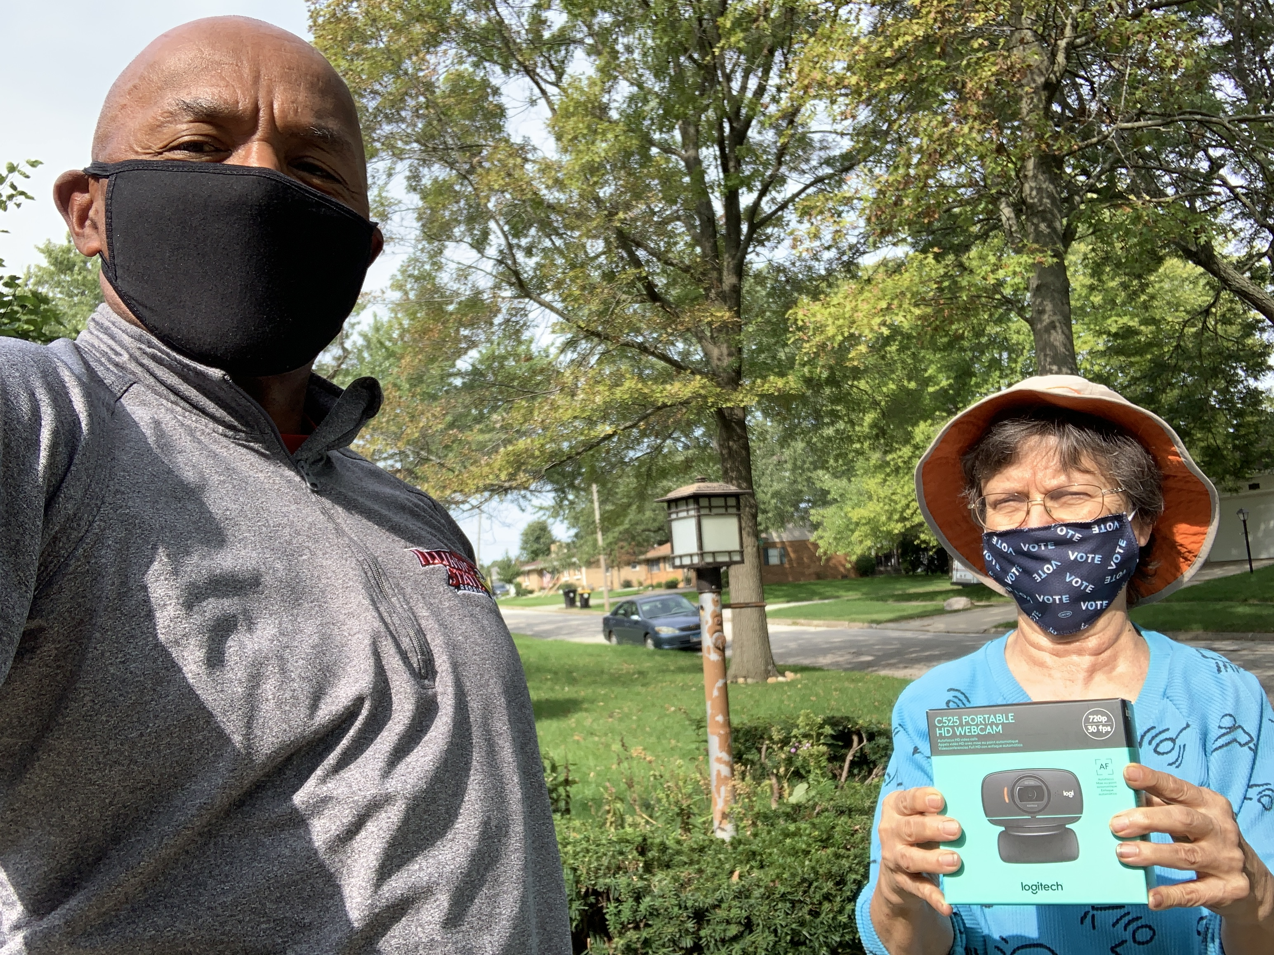
DIGITAL PROGRAMMING
Notes:
The shift to digital programming was not without its challenges: Reluctance (and fear) to use technology; outdated equipment and lack of connectivity and access; continual follow-up to teach a senior how to use technology; refusal to use technology.
The most successful digital programs were ARC Avid Readers Book Club, Great Books, Grief Support, Tai Chi and Meditation, Bingo, and Medicare presentations and counseling.

Slide 8
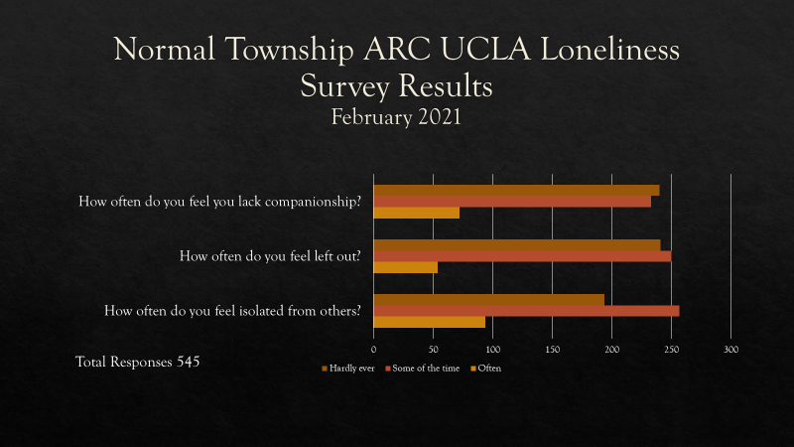
Notes:
During the early part of 2021, ARC conducted a survey of the membership using the UCLA Loneliness Survey. 545 members completed the survey
How often do you feel that you lack companionship? Hardly ever 240 (44.04%) Some of the time 233 (42.75%) Often 72 (13.21%) Total Responses 545
How often do you feel left out? Hardly ever 241 (44.22%) Some of the time 250 (45.87%) Often 54 (9.91%) Total Responses 545
How often do you feel isolated from others? Hardly ever 194 (35.6%) Some of the time 257 (47.16%) Often 94 (17.25%) Total Responses 545

Slide 9
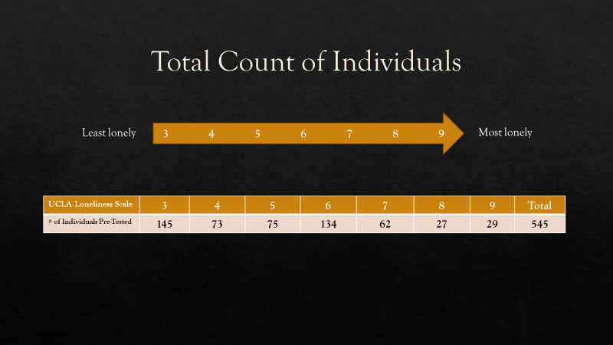
Notes:
Trends:
Partner/Spouse/Companions
“Since Covid, and after 36 years together, my husband & I have probably spent more time together than ever before. It's almost as if it has been a blessing in disguise.”
“My husband and I sleep different "shifts", so I am alone a lot. I only have a few friends and don't hear from them often.”
“Gets really tough on both husband and wife to be so limited in social contacts. Need the interaction and distraction.”
“My husband and I live in a large home and family and friends come to stay all the time. I'm very grateful.”
“I am an introvert who needs less people time than many do. I am also married, and my husband and I are companionable friends. That really helps.”
“My wife and I get along well, and she is an excellent companion. Her companionship prevents me from feeling isolated despite the circumstances.”
Widows and Widowers
“I am a fairly recent widow but during quarantine, my family has been very attentive to my needs and give me company and support when I ask for it, but they also leave me alone if I ask for space. I do miss seeing my friends at ARC and elsewhere but am dealing.”
“I'm a widow now for 1 1/2 years and it's a different walk. I have a good family and they take care of me but there are still times I just feel lonely.”
“Since Covid restrictions I have felt very lonely because I am a widow and live alone. ARC is my social and exercise outlet I miss that connection.”
“Thank God this widow has a girlfriend to offset this COVID ordeal.”
Social isolation and loneliness
“Obviously feel isolated from others due to my age, comorbidities, and Covid, but understand that it has to be.”
“While not accessing the fitness center I feel more isolated, less motivated, physically weaker.”
Sometimes I feel lonely and feel like I am going to cry, but I tell myself it does not help a thing and try to think about something else to help get over it.”
“With COVID 19, I feel more isolated since I am unable to participate in my volunteering activities and being able to see and visit with my friends. I do feel lonely at times, but my faith keeps me going.”

Slide 10
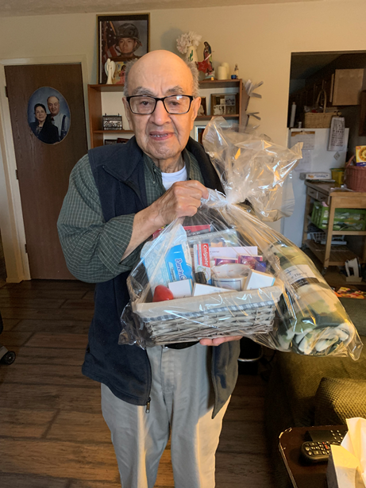
COMBATING SOCIAL ISOLATION DURING A PANDEMIC…
2495 Telephone Reassurance calls made
4018 Birthday calls made
80 Sympathy cards sent
5 Friendly visits
850+ Digital programs presented
11 IL Care Connections tablets distributed
4 Web cams distributed
13 Echo Show devices distributed
5 Chromebooks to be distributed

Slide 11
NEXT STEPS….
Volunteer Coordinator
Resume Friendly Visits
Continue Telephone Reassurance for homebound members
Continue Get Well and Sympathy Cards
Continue Birthday Calls
Partner w/Peace Meal
Veterans Outreach
Notes:
Formalize the Volunteer Coordinator position to take an active role in managing the Sunshine Program. Duties include identifying homebound seniors and seniors for Get Well and Sympathy cards; assembling goody baskets; hiring and assigning volunteers; coordinating Veterans Outreach.

