Slide 1

FY 2016 POMP Home Delivered Meals Satisfaction Survey
Tuesday, January 17, 2017

Slide 2
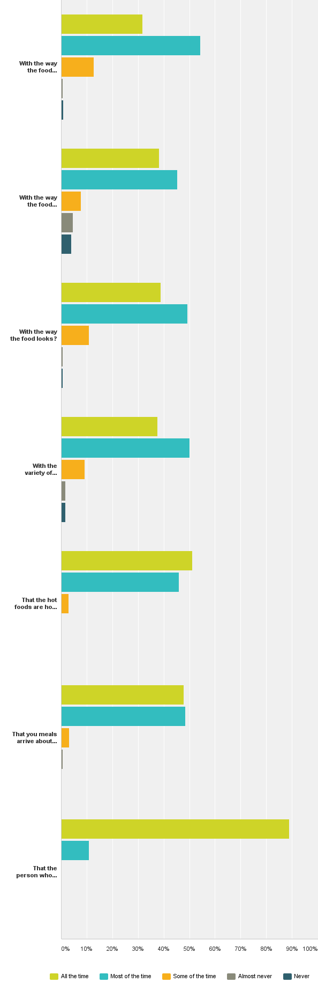
Q1: Think about all the foods that you receive from the home delivered meals program. Now tell me, are you satisfied...
Answered: 380 Skipped: 0

Slide 3
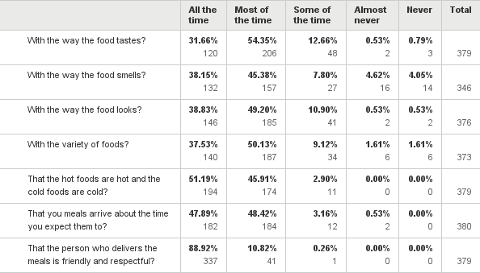
Q1: Think about all the foods that you receive from the home delivered meals program. Now tell me, are you satisfied...
Answered: 380 Skipped: 0

Slide 4
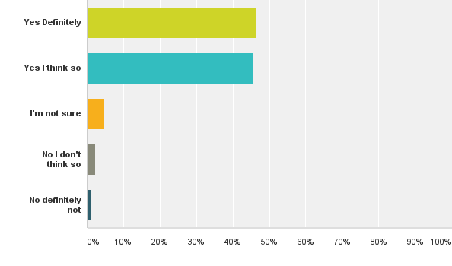
Q2: As a result of receiving home delivered meals I eat a healthier variety of food
Answered: 380 Skipped: 0

Slide 5
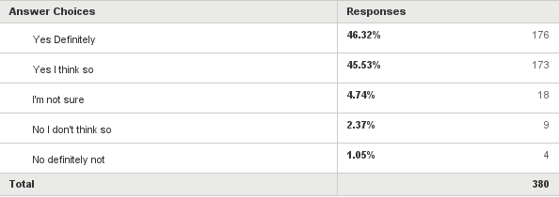
Q2: As a result of receiving home delivered meals I eat a healthier variety of food
Answered: 380 Skipped: 0

Slide 6
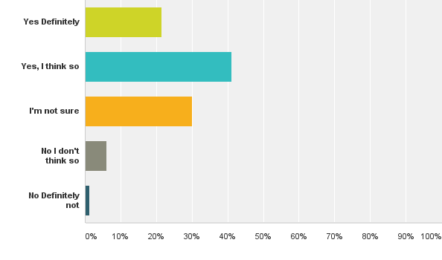
Q3: As a result of receiving home delivered meals I believe my health has improved and I feel better
Answered: 377 Skipped: 3

Slide 7
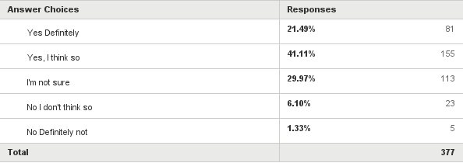
Q3: As a result of receiving home delivered meals I believe my health has improved and I feel better
Answered: 377 Skipped: 3

Slide 8
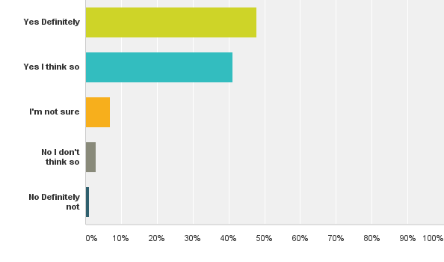
Q4: Because I recieve home delivered meals I can continue to live in my own home
Answered: 376 Skipped: 4

Slide 9
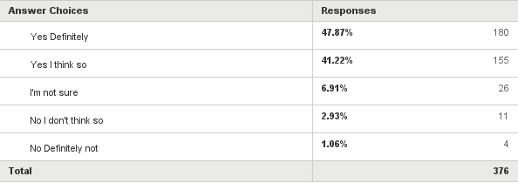
Q4: Because I recieve home delivered meals I can continue to live in my own home
Answered: 376 Skipped: 4

