Slide 1
FY 2016 POMP Congregate Meals Survey
Tuesday, January 17, 2017

Slide 2
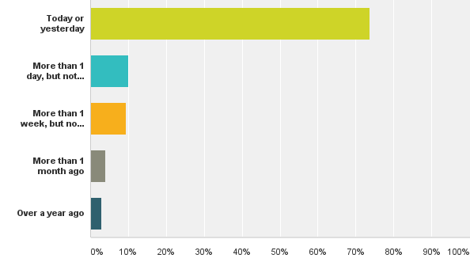
Q1: When was the last time you ate at the senior center or meal site?
Answered: 601 Skipped: 2

Slide 3
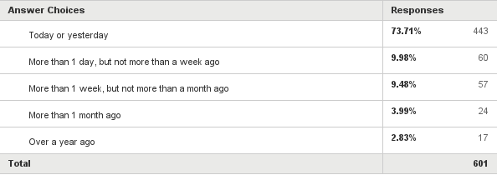
Q1: When was the last time you ate at the senior center or meal site?
Answered: 601 Skipped: 2

Slide 4
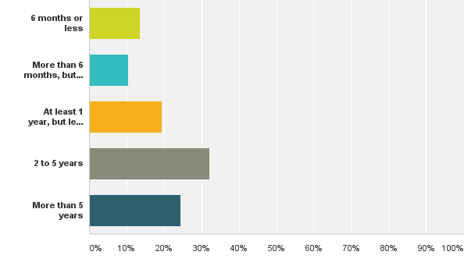
Q2: How long have you been attending the meal program? Would you say...
Answered: 577 Skipped: 26

Slide 5
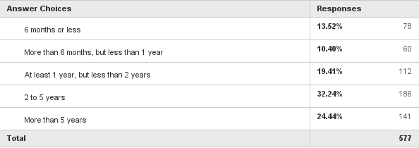
Q2: How long have you been attending the meal program? Would you say...
Answered: 577 Skipped: 26

Slide 6
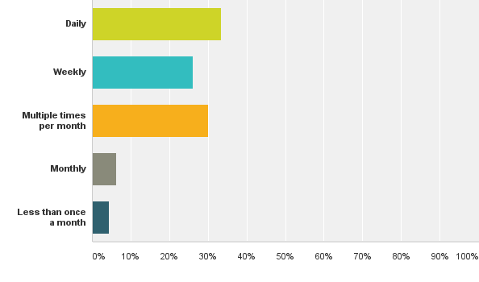
Q3: How often do you eat at the senior center or meal site?
Answered: 580 Skipped: 23

Slide 7
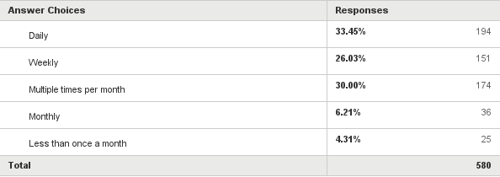
Q3: How often do you eat at the senior center or meal site?
Answered: 580 Skipped: 23

Slide 8
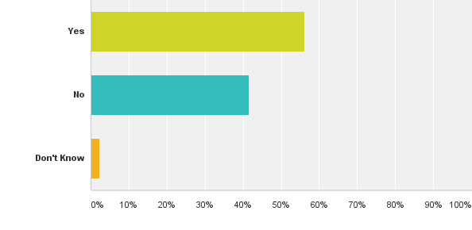
Q4: On the days you eat at the senior center or meal site, are the meals your main source of food?
Answered: 575 Skipped: 28

Slide 9
Q4: On the days you eat at the senior center or meal site, are the meals your main source of food?
Answered: 575 Skipped: 28

Slide 10
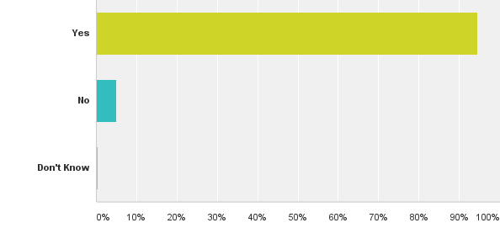
Q5: When you eat at the senior center or meal site, do you usually eat the fruit when it is provided?
Answered: 578 Skipped: 25

Slide 11
Q5: When you eat at the senior center or meal site, do you usually eat the fruit when it is provided?
Answered: 578 Skipped: 25

Slide 12
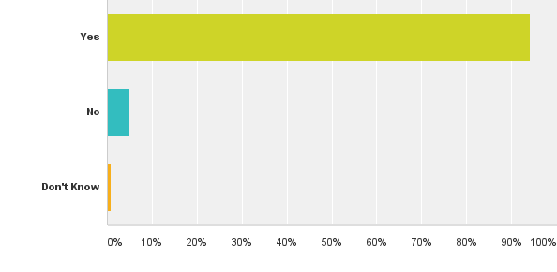
Q6: When you eat at the senior center or meal site, do you usually eat the vegetables that are provided?
Answered: 573 Skipped: 30

Slide 13
Q6: When you eat at the senior center or meal site, do you usually eat the vegetables that are provided?
Answered: 573 Skipped: 30

Slide 14
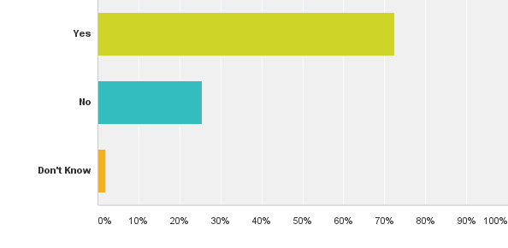
Q7: When you eat at the senior center or meal site, do you usually eat or drink the milk, cheese, yogurt, or soy milk, soy cheese, or soy yogurt that are provided?
Answered: 571 Skipped: 32

Slide 15
Q7: When you eat at the senior center or meal site, do you usually eat or drink the milk, cheese, yogurt, or soy milk, soy cheese, or soy yogurt that are provided?
Answered: 571 Skipped: 32

Slide 16
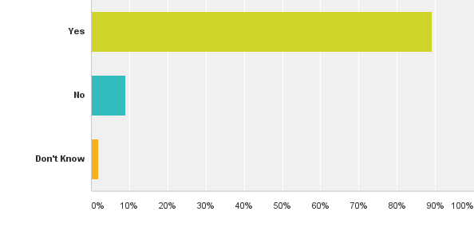
Q8: When you eat at the senior center or meal site, do you usually eat the beans, nuts, eggs, or tofu when they are provided?
Answered: 573 Skipped: 30

Slide 17
Q8: When you eat at the senior center or meal site, do you usually eat the beans, nuts, eggs, or tofu when they are provided?
Answered: 573 Skipped: 30

Slide 18
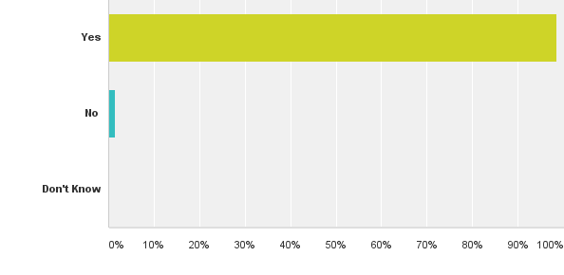
Q9: When you eat at the senior center or meal site, do you usually eat the meat, turkey, chicken, or fish that is provided?
Answered: 578 Skipped: 25

Slide 19
Q9: When you eat at the senior center or meal site, do you usually eat the meat, turkey, chicken, or fish that is provided?
Answered: 578 Skipped: 25

Slide 20
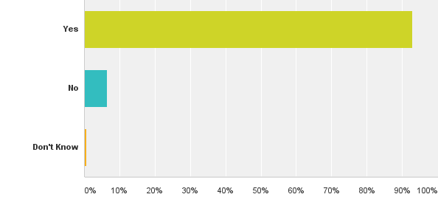
Q10: When you eat at the senior center or meal site, do you usually eat the bread, rice, pasta, or noodles that are provided?
Answered: 568 Skipped: 35

Slide 21
Q10: When you eat at the senior center or meal site, do you usually eat the bread, rice, pasta, or noodles that are provided?
Answered: 568 Skipped: 35

Slide 22
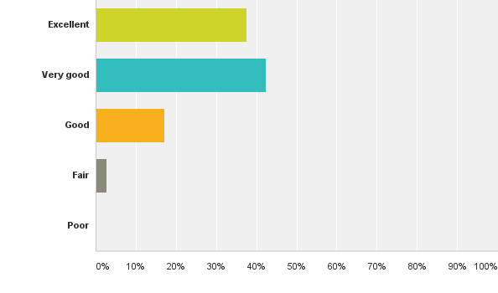
Q11: Overall, how would you rate the meal program?
Answered: 568 Skipped: 35

Slide 23
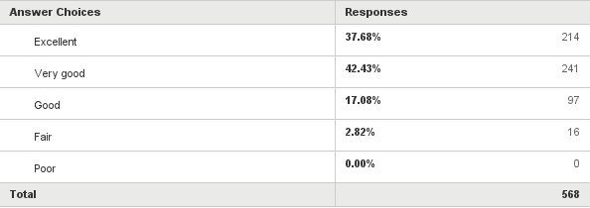
Q11: Overall, how would you rate the meal program?
Answered: 568 Skipped: 35

Slide 24
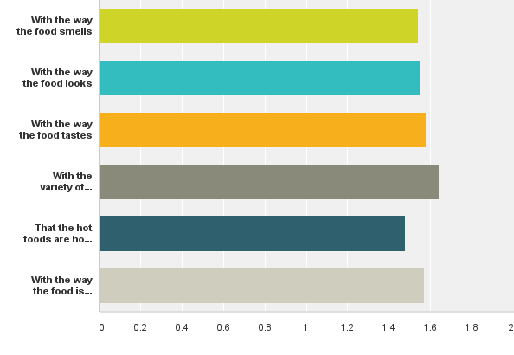
Q12: Think about the foods that you receive from the meal program. Please tell us, how often are you satisfied...
Answered: 572 Skipped: 31

Slide 25
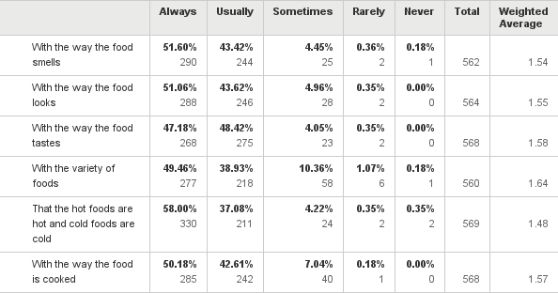
Q12: Think about the foods that you receive from the meal program. Please tell us, how often are you satisfied...
Answered: 572 Skipped: 31

Slide 26
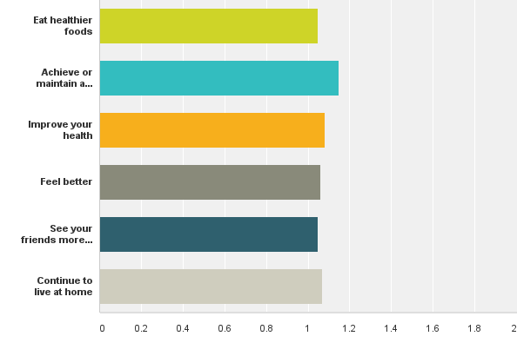
Q13: Please answer the following questions about the meal program. Do services received at the meal program help you to...
Answered: 550 Skipped: 53

Slide 27
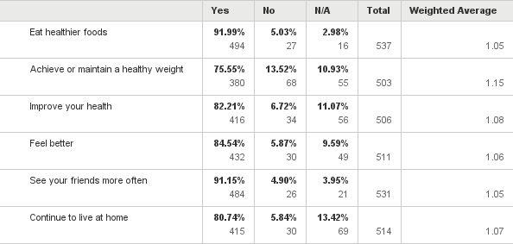
Q13: Please answer the following questions about the meal program. Do services received at the meal program help you to...
Answered: 550 Skipped: 53

Slide 28
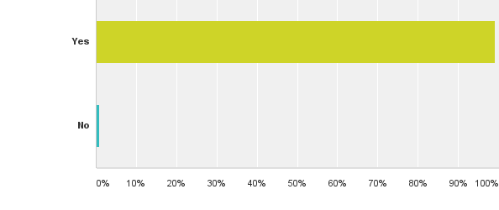
Q14: Do you like the meals you get from the meal program?
Answered: 555 Skipped: 48

Slide 29
Q14: Do you like the meals you get from the meal program?
Answered: 555 Skipped: 48

Slide 30
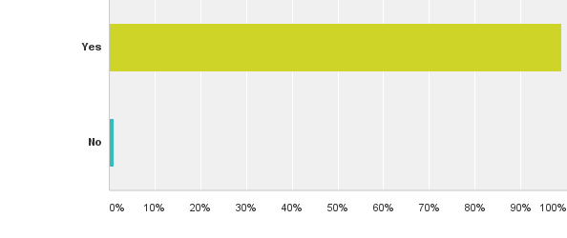
Q15: Would you recommend the meal program to a friend?
Answered: 564 Skipped: 39

Slide 31
Q15: Would you recommend the meal program to a friend?
Answered: 564 Skipped: 39

Slide 32
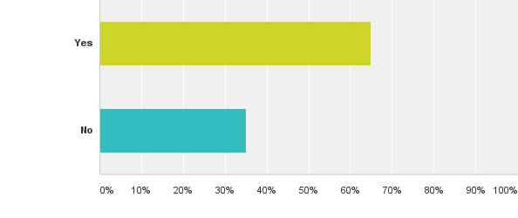
Q16: As a result of attending the meal program, do you have a better idea of where to get information about other services?
Answered: 535 Skipped: 68

Slide 33
Q16: As a result of attending the meal program, do you have a better idea of where to get information about other services?
Answered: 535 Skipped: 68

Slide 34
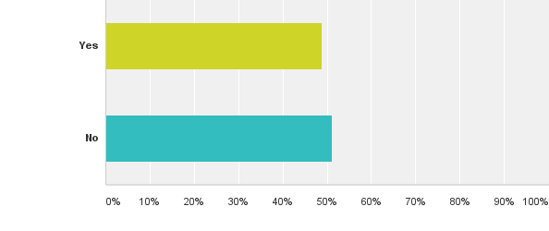
Q17: While you are at the meal program, do you learn about food safety tips for cooking and storing food?
Answered: 530 Skipped: 73

Slide 35
Q17: While you are at the meal program, do you learn about food safety tips for cooking and storing food?
Answered: 530 Skipped: 73

Slide 36
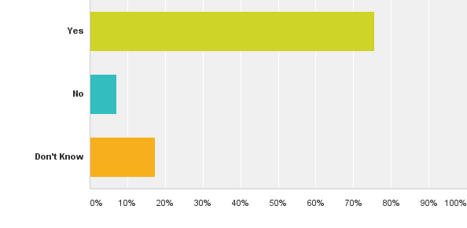
Q18: As a result of your participation in the meal program, do you feel that you make more healthful and nutritious choices?
Answered: 554 Skipped: 49

Slide 37
Q18: As a result of your participation in the meal program, do you feel that you make more healthful and nutritious choices?
Answered: 554 Skipped: 49

Slide 38
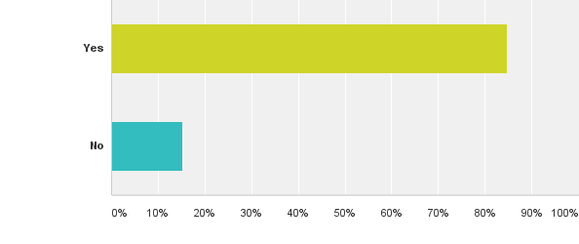
Q19: Do you know that the congregate meal donation is voluntary?
Answered: 542 Skipped: 61

Slide 39
Q19: Do you know that the congregate meal donation is voluntary?
Answered: 542 Skipped: 61

Slide 40
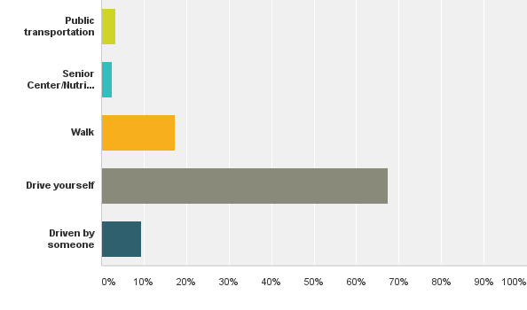
Q20: How do you get to the senior center or meal site?
Answered: 540 Skipped: 63

Slide 41
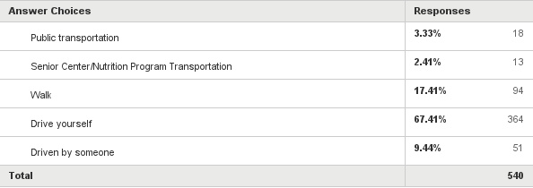
Q20: How do you get to the senior center or meal site?
Answered: 540 Skipped: 63

Slide 42
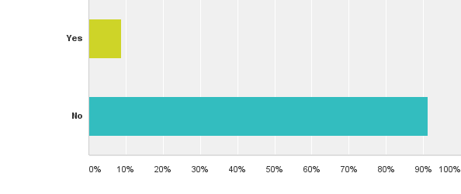
Q21: Are there times when you have not been able to attend the meal program because you had no way to get there?
Answered: 557 Skipped: 46

Slide 43
Q21: Are there times when you have not been able to attend the meal program because you had no way to get there?
Answered: 557 Skipped: 46

Slide 44
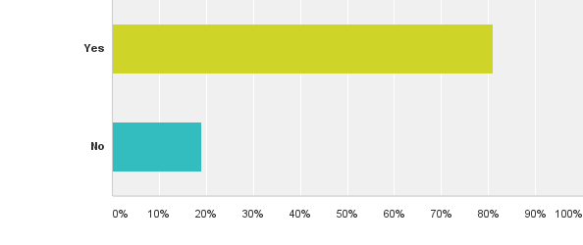
Q22: Do you always have enough money or food assistance/food stamps/SNAP to buy the food you need?
Answered: 554 Skipped: 49

Slide 45
Q22: Do you always have enough money or food assistance/food stamps/SNAP to buy the food you need?
Answered: 554 Skipped: 49

Slide 46
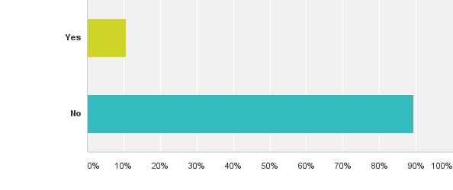
Q23: During the past month, did you have to choose between buying food or buying medications?
Answered: 559 Skipped: 44

Slide 47
Q23: During the past month, did you have to choose between buying food or buying medications?
Answered: 559 Skipped: 44

Slide 48
Q24: During the past month, did you have to choose between buying food or paying your rent or utility bills?
Answered: 557 Skipped: 46

Slide 49
Q24: During the past month, did you have to choose between buying food or paying your rent or utility bills?
Answered: 557 Skipped: 46

Slide 50
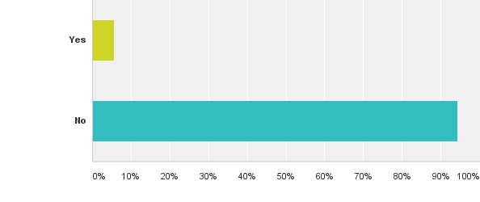
Q25: On one or more days during the past month, did you skip meals because you had no food and no money or food assistance/food stamps/SNAP to buy food?
Answered: 560 Skipped: 43

Slide 51
Q25: On one or more days during the past month, did you skip meals because you had no food and no money or food assistance/food stamps/SNAP to buy food?
Answered: 560 Skipped: 43

Slide 52
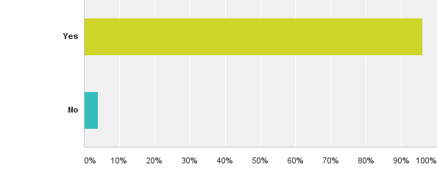
Q26: In general, would you say that the meal program has helped you?
Answered: 554 Skipped: 49

Slide 53
Q26: In general, would you say that the meal program has helped you?
Answered: 554 Skipped: 49

Slide 54
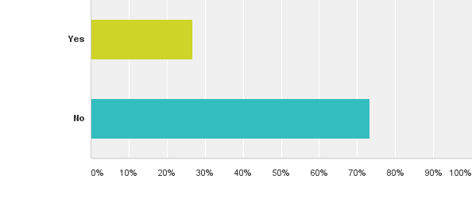
Q28: Do you have any recommendations to improve the meal program?
Answered: 510 Skipped: 93

Slide 55
Q28: Do you have any recommendations to improve the meal program?
Answered: 510 Skipped: 93
(1) Written response for yes – “Fish and chicken grilled.”

